Slide 1
Chapter 10.4
Capillary Fluid Exchange

Slide 2
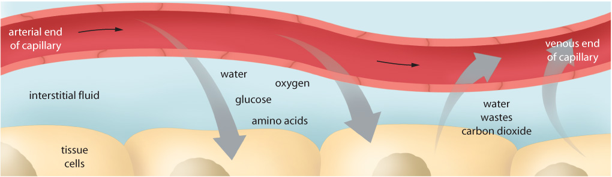
Capillary Exchange
blood travels the following circuit: arteries → ?
blood moves through capillary very slowly
this allows time for exchange of materials between blood and tissue fluid (ECF)
CO2(g) and O2(g) move in and out of capillary by process of DIFFUSION
water moves out of arteriole and carries sugar, amino acids, wastes, hormones, vitamins
these diffuse into tissue as well

Slide 3
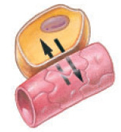
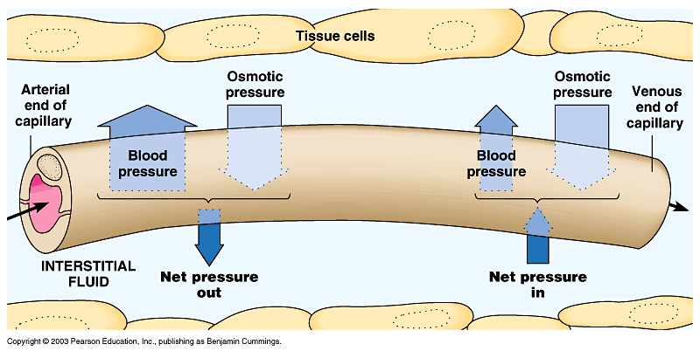
Capillary Fluid Exchange
Capillaries provide cells with oxygen, glucose and amino acids and are associated with fluid exchange between the blood and surrounding extracellular fluid (ECF).

Slide 4
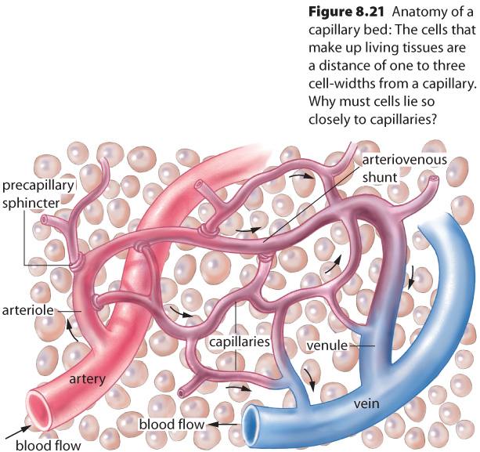
Most fluids, oxygen and carbon dioxide diffuse through capillaries.
Water and certain ions pass through spaces between cells of the capillaries
Larger molecules and some proteins are exchanged by endocytosis or exocytosis.

Slide 6
Fluid pressure and osmotic pressure regulate water between the blood and ECF
1. osmotic pressure:
moves water from tissue fluid into blood
osmotic pressure constant: 25 mm of Hg (millimeters of mercury)
2. blood pressure:
moves water from blood into tissue fluid
blood pressure is :
35-40 mmHg at the arteriole end of capillary
10-15 mm Hg at the venule end
Water moves from an area of high pressure to an area of low pressure
The outward flow of water and small mineral ions is known as filtration.
Capillaries are selectively permeable so proteins, red blood cells and white blood cells remain in the capillaries

Slide 7
Fluid in and out of the capillaries must be balanced
Large proteins are found in the blood and not in the ECF
Osmotic pressure draws water back into the capillaries
The proteins in blood and dissolved minerals are responsible for the movement of fluids into the capillaries

Slide 8
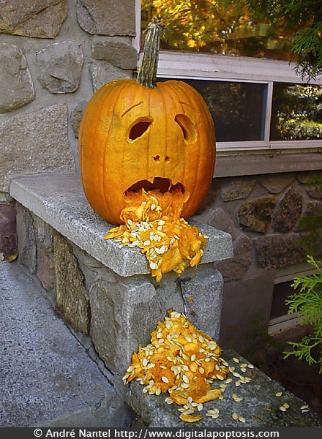
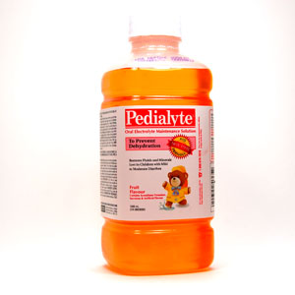
Movement of fluid into capillaries is called absorption.
Concentration of solutes in the blood can change due to fluid intake and excess fluid loss through perspiration, vomiting or diarrhea

Slide 9
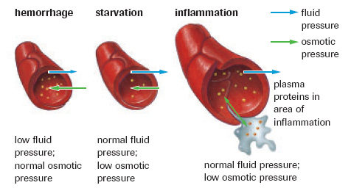
The figure down below shows the application of the capillary exchange that models adjustments that help maintain equilibrium between osmotic pressure and fluid pressure.

Slide 10
Lymphatic System
Slow leakage of proteins from capillaries into the ECF accumulate and then causes osmotic pressure to decrease and tissues would swell.
Proteins are drained from the ECF and returned to the circulatory system by way of another network of vessels: the lymphatic system

Slide 11
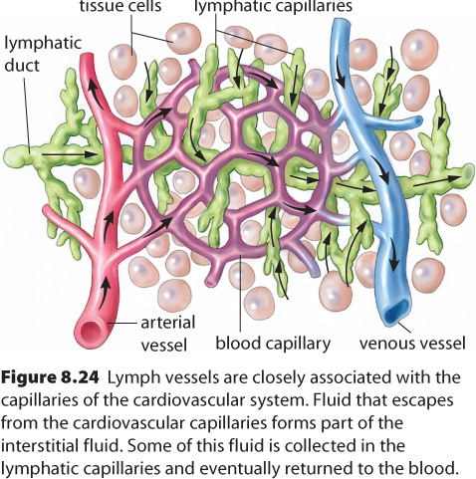
Lymphatic System (p 337)
lymphatic vessels capture:
excess fluids leaked from capillaries
collect products of fat digestion (glycerol, fatty acids, and fat soluble vitamins) from small intestine
fluid is called lymph and is and dumped into veins
flows one way only
lymph vessels called lacteals are in villi in small intestine

Slide 12
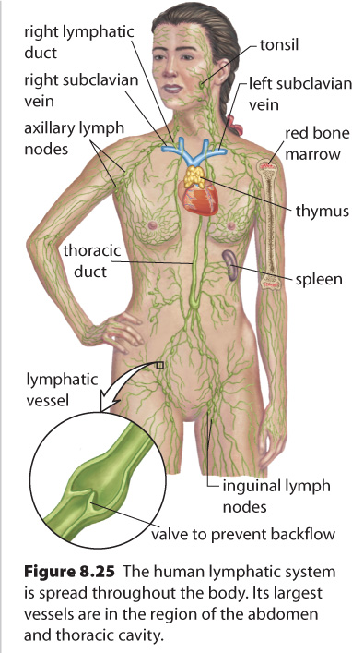
The Lymphatic System

Slide 13
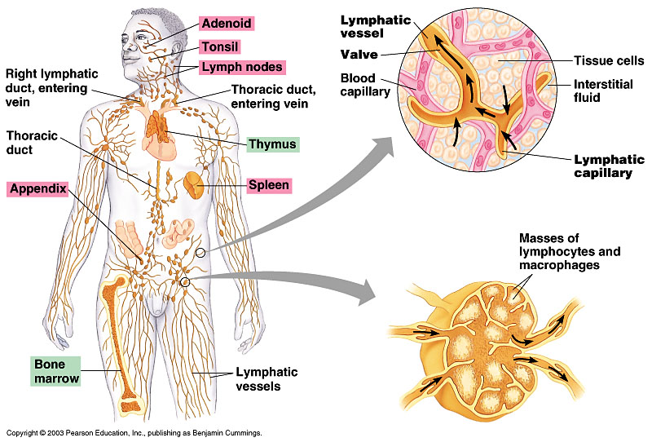

Slide 14
Lymph- a fluid similar to blood plasma is transported in open-ended lymph vessels that are similar to veins.
Operates by slow muscle contractions against the vessels, which are supplied with flap like valves that prevent the backflow of fluids.
Lymph is returned to the venous system via the right and left subclavian veins.

Slide 15
Lymph Nodes - a mass of tissue that stores lymphocytes and removes bacteria and foreign particles from lymphs (through phagocytosis). Found at intervals along lymph vessels.
Lymphocyte- a white blood cell that produces antibodies.
When your throat is sore your lymph nodes sometimes swell in your neck.

Slide 16
Lymphoid Organs
Red Bone Marrow- where all types of blood cells are produced.
Stem Cells (found in marrow)- divide at incredible rates and differentiate into different types of white blood cells.
In children red bone marrow is found in most bones; where as in adults it is found primarily in the cranium, sternum, ribs, spinal column, and the long bones of the arms and legs – responsible for blood cell production

Slide 17
Spleen-largest lymphoid organs. Upper left side of the abdominal cavity, just below the diaphragm. It is an excellent blood reservoir.
The spleen releases red blood cells in response to low blood pressure or when oxygen levels drop dramatically. (helps purify blood)

Slide 18
Thymus gland- gets smaller with age. Front of trachea, just above the heart.
Where T lymphocytes or T cells mature.
T-cells help ensure that they will not initiate an immune response against the body’s own proteins.

Slide 20
Review Questions
Pg 339 - #1-7

