Slide 1
Terrestrial and Aquatic Ecosystems
4.2 pgs. 94 - 100

Slide 2
Biomes
A large geographical region with a specific range of temperatures and precipitation, and the organisms that are adapted to those conditions of temperature and precipitation

Slide 3
Biomes of the World

Slide 4
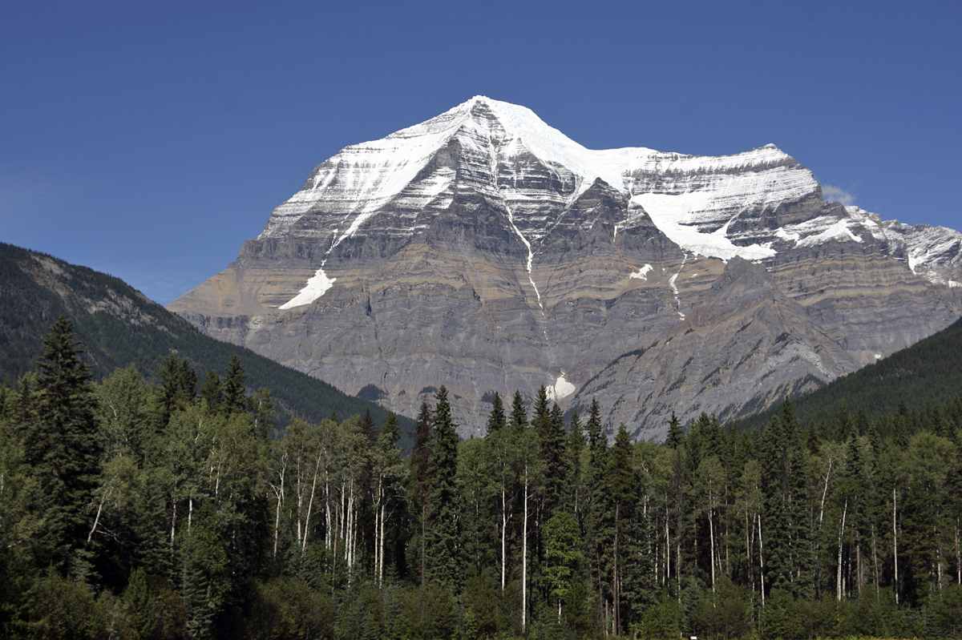
Terrestrial Ecosystems

Slide 5
Terrestrial Ecosystems
Ecosystems that are found anywhere on Earth that is not covered by water.
Alberta’s terrestrial ecosystems are found within two major biomes: Taiga and Grassland

Slide 6
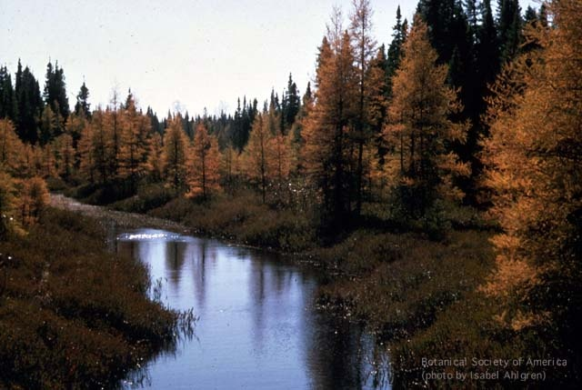
Taiga Biome

Slide 7
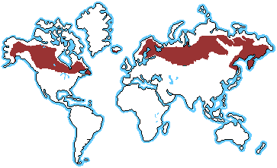
Taiga Biome Map

Slide 8
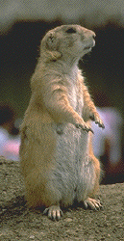
Grassland Biome

Slide 9
Grassland Biome Map

Slide 10
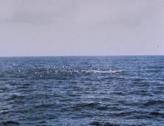
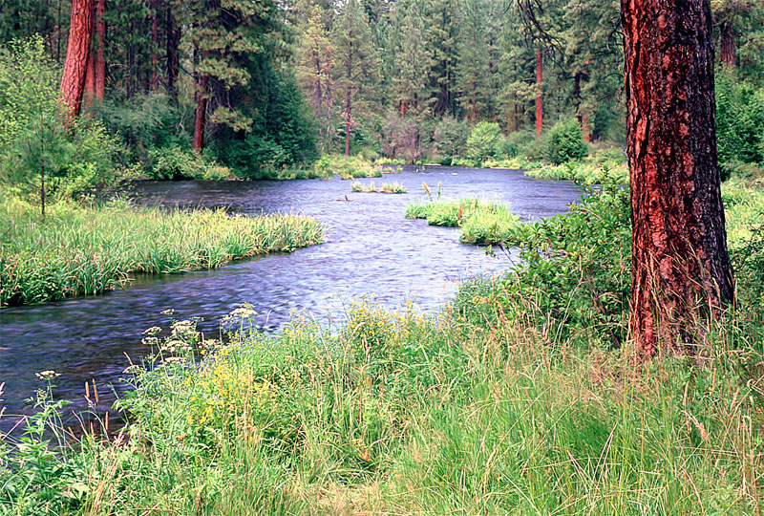
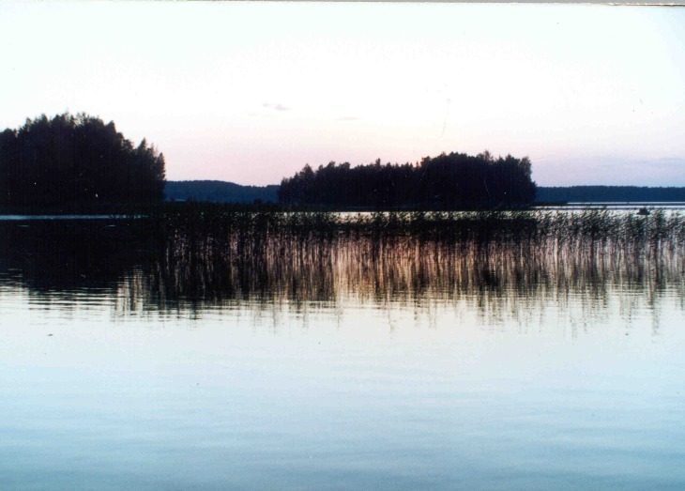
Aquatic Ecosystems
Aquatic ecosystems are found in ponds, rivers, lakes and oceans.

Slide 11
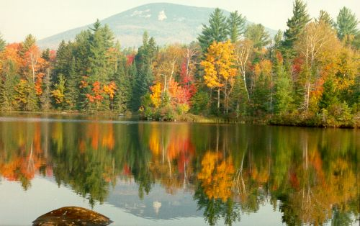
In Alberta, the major aquatic ecosystems are freshwater ecosystems. (lakes)

