Slide 1
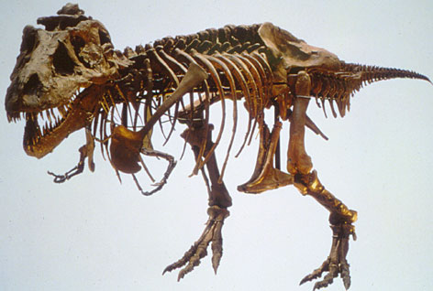
Evidence of a Changing Earth
5.2
Pgs. 140 - 143

Slide 2
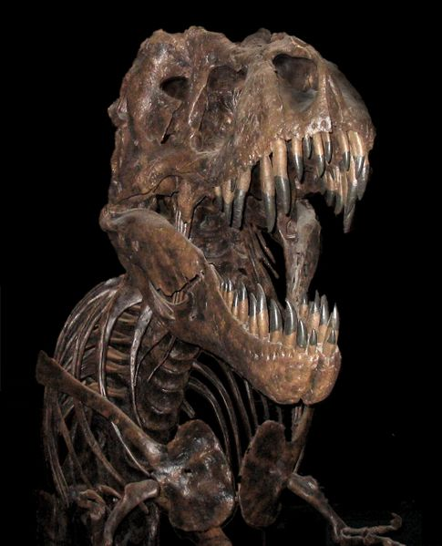
Evidence from Fossils
Paleontology – the study of fossils
Fossil Formation – commonly formed when bodies of organisms become trapped in sediments.
- Only a fraction of the species that have lived on Earth have left fossil evidence
(fossils are a fluke)

Slide 3
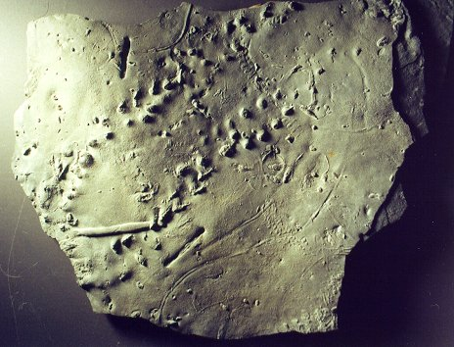
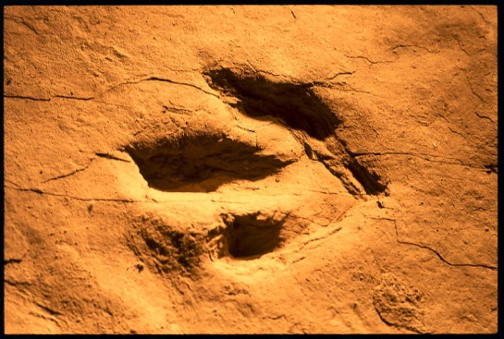
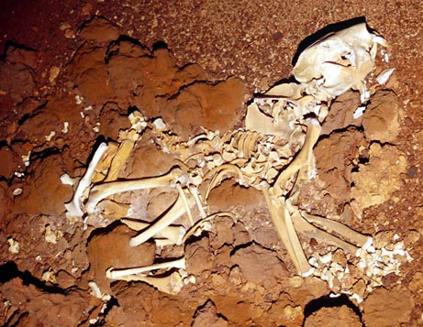
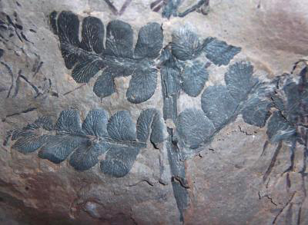
Types of Fossils:
Burrows
Footprints
Chemical remains
Impressions
Actual remains

Slide 4
Fossils are Direct Physical Evidence that:
Different species lived on Earth at various times in the past – very few of today’s species were alive even 1 million years ago
The complexity of living organisms generally increases from the past to the present. More ancient fossils lack complexity compared to present day organsims

Slide 5
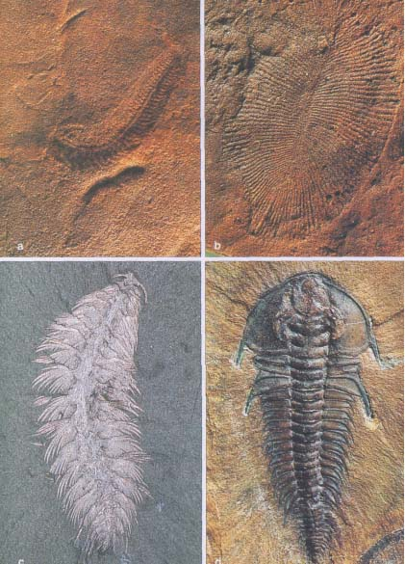
Living species and their most closely matching fossils are typically located in the same geographic region.

Slide 6
Dating the Past
Radioactive isotopes – decay at a set rate regardless of temperature, moisture or other environmental conditions.
Example: a radioactive isotope: uranium 238 decays into lead 206. The amount of time it takes for half of a sample of parent material to decay into daughter material is known as a half-life.

Slide 7
Radiometric Dating
A technique used to determine the age of rock or fossil.
The use of several different isotopes can provide age estimates with a very small margin of error.
The oldest fossils of living things discovered so far date to approximately 3.8 billion years.

Slide 8
Evidence from Biogeography
Biogeography – the study of the geographic distribution of life on Earth
About 225 million years ago, Earth’s continents were part of one landmass

Slide 9
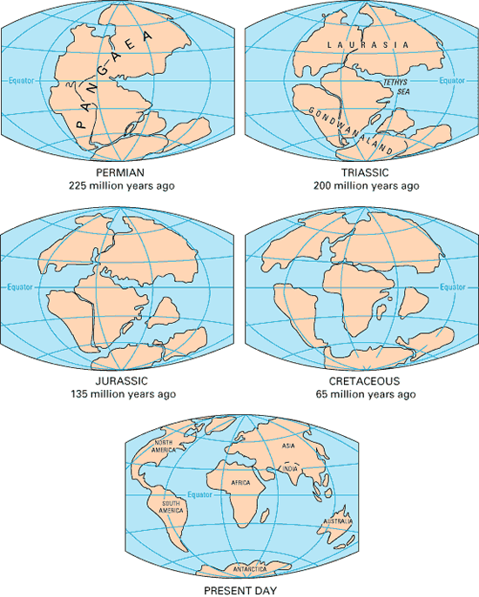
Continental Drift

Slide 10
Fossils of some species that date 150 million years ago or older were once in the same geographic region, but are now distributed on different continents
Fossils of more recent species are found on separate continents
This suggests the newer species evolved after the breakup of the continents

Slide 11
Classwork
Page 143 # 1-3

