Slide 1
Enzymes
8.2

Slide 2
Enzymes
Chemical reactions are continually occurring in our bodies to keep us alive.
These chemical reactions must occur at low temperatures so that cells in our body are not damaged.
Catalysts – are chemicals that increase the rate of reactions without increasing the temperature or changing the substance being made
Proteins in our bodies that act as catalysts are called enzymes.

Slide 3
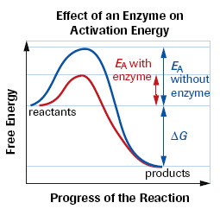
Enzymes cont . .
Enzymes also help reactions occur at a lower energy level.
Enzymes are not changed during a reaction.
Enzymes can be identified by an “ase” ending
i.e protease, lipase

Slide 4
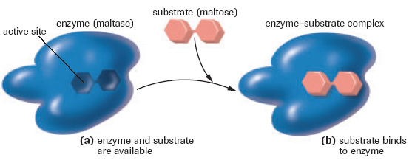
Enzymes cont . .
The structure the enzyme binds to is called the substrate.
The area on the enzyme where the substrate binds is called the active site.
There is a different active site for every enzyme – substrate combination
Once the substrate is bound the enzyme then helps to change the substrate into the product.

Slide 5
Enzymes helpers
Cofactors and coenzymes are enzyme helpers.
They help the enzyme bind to the substrate
Cofactors are inorganic – iron, zinc, potassium
Coenzymes are organic – made from vitamins

Slide 6
Factors Affecting Enzyme Reactions
pH
different enzymes function the best at different pH levels, there is a range for each enzyme
if the solution is too acidic (high H+ levels), or too basic (high OH - ) the hydrogen bonds that determine the enzymes structure will change.
a change in enzyme structure will affect its function

Slide 7
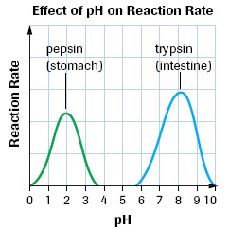
pH

Slide 8
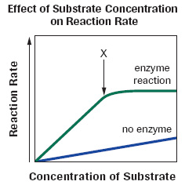
Factors Affecting Enzyme Reactions
Substrate Molecule Concentration
The greater the number of substrates the greater the number of interactions (more substrates will bind with enzymes)
This increase will plateau
when all of the enzymes
are bound to a substrate

Slide 9
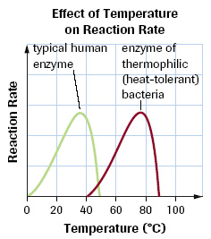
Factors Affecting Enzyme Reaction
Temperature
As the temperature increases the number of substrate – enzyme interactions increase and more products are made
In humans the temperature cannot exceed 37◦ - why do you think this is the case?
too much heat will cause denaturation of the enzyme

Slide 10
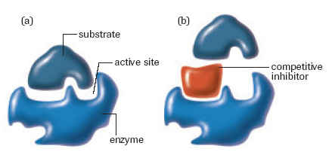
Factors Affecting Enzyme Reaction
Competitive Inhibitors
Competitive inhibitors resemble the substrate
The inhibitor binds to the enzyme, preventing the enzyme from binding to the substrate

Slide 11
Regulation of Enzyme Activity
The production of chemicals in our bodies (e.g. hormones) follows a metabolic pathway with enzymes helping along the way
The production of chemicals in our body is regulated by our bodies need for that chemical
A) Feedback Inhibition – the inhibition (stopping) of an enzyme in a metabolic pathway by the final product of the pathway.

Slide 12
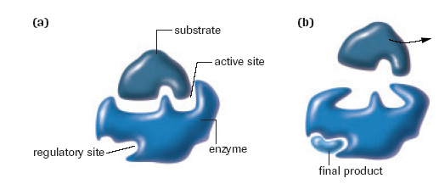
Regulation of Enzyme Activity
The final product binds to the regulatory site of the enzyme preventing it from binding to any more substrates

Slide 13
Regulation of Enzyme Activity
B) Precursor activity – the activation of the last enzyme in a metabolic pathway by the initial substrate
This occurs to help speed up the reaction when there is a build up of the initial substrate
The binding of the initial substrate to the enzyme improves the enzyme-substrate fit
Note: both feedback inhibition and precursor activity involve molecules binding to the regulatory sight of the enzyme

Slide 14
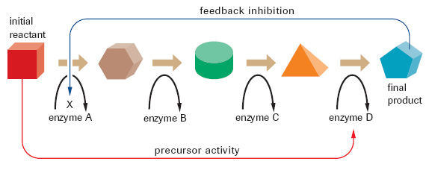
Regulation of Enzyme Activity
Both feedback inhibition and precursor activity are called allosteric activities
Allosteric activity is a change in an enzyme caused by the binding of a molecule

Slide 15
Review
questions 1-3 and 5
page 258
Notes:
-

