Slide 1
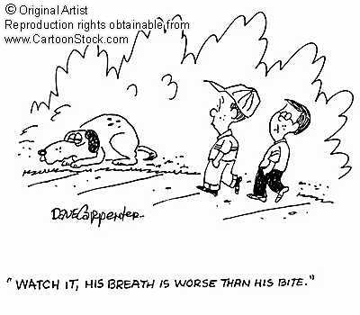
9.2 pages: 288-291
Gas Exchange and Transport

Slide 2
Dalton’s Law of Partial Pressure
Each gas in a mixture exerts it’s own pressure, which is proportional to the total volume (of the mixture)
Gases diffuse from an area of high partial pressure to an area of lower partial pressure
The highest partial pressure of oxygen is found in atmospheric air.
Oxygen diffuses from the air (21.2 kPa) into the lungs (13.3 kPa for the alveoli)

Slide 3
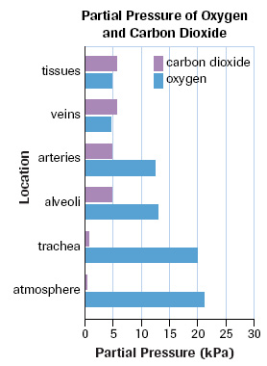

Slide 4
Gas moves from high pressure to
low pressure
High pressure of O₂ in your arteries moves
into your body cells (Arteries 12.6 kPa of O₂₎
High pressure of CO2 in your body cells so it moves into your veins (Veins 5.3 kPa of O₂)
Oxygen moves from the capillaries into the cells to supply the tissue with oxygen

Slide 5
Oxygen Transport
Oxygen from the atmosphere→ alveoli→ blood
Hemoglobin – the oxygen carrying molecule in red blood cells
When oxygen dissolves into the plasma, hemoglobin forms a weak bond with the oxygen molecule to form oxyhemoglobin
This can allow the blood to carry 20 mL of oxygen per 100 mL of blood

Slide 6
Blood diffusing into the capillaries from the lungs drops pressure to about 5.3 kPa from about 13.3 kPa in the lungs
This drop in partial pressure causes the dissociation, or split, of oxygen from the hemoglobin and oxygen diffuses into the tissues

Slide 7
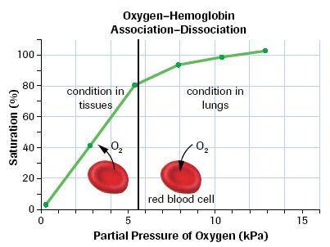
Partial pressures/ diffusion of oxygen/ carbon dioxide:
http://highered.mcgraw-hill.com/sites/0072437316/student_view0/chapter44/animations.html#

Slide 8
Carbon Dioxide Transport
27% of CO₂ is carried in red blood cells
64% of CO₂ is converted by carbonic anhydrase to carbonic acid H₂CO₃
9 % is in the plasma
converting CO₂ into carbonic acid (H₂CO₃) decreases the concentration of CO₂ in the blood so that CO₂ will continue to move into the blood . . BUT . . it decrease the pH which can be potentially deadly

Slide 9
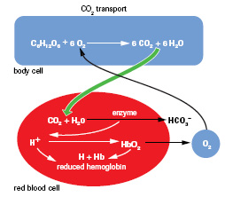

Slide 10
Hemoglobin as a Buffer
Carbonic acid H₂CO₃ dissociated into H⁺ and HCO₃
Hemoglobin picks up the H⁺ ions, working to maintain the bloods pH levels
When the hemoglobin reaches the lungs H⁺ is replaced by O₂
The H⁺ is converted back into an acid which quickly dissociated into CO₂ and H₂O , this increase in CO₂ concentration is released into the lungs and exhaled

Slide 11
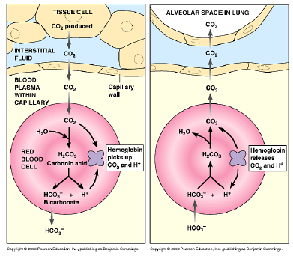

Slide 12
