Slide 1
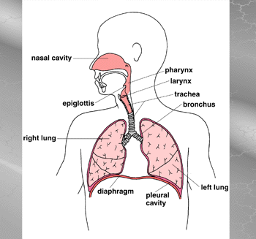
Regulation of Breathing Movement 9.3 pg 292-297
Chapter 12

Slide 2
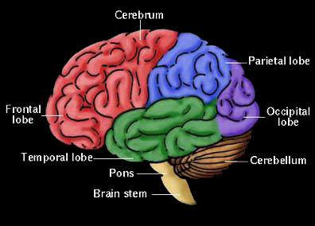
Breathing Movements
Breathing Movements- controlled by the nervous system from the medulla oblongata in the brain
2 Chemoreceptors
- (nerve receptors that
are sensitive to
specific
chemicals)

Slide 3
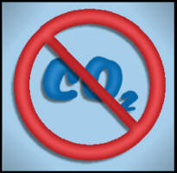
1. Carbon Dioxide Chemoreceptor
located in the medulla oblongata
sensitive to the levels of CO₂ and acid in the blood
activated when CO₂ levels in the blood increase
relays a message to the diaphragm and intercostal muscles to initiate breathing
increased breathing rate,
decreases the levels of CO₂ in the blood
CO₂ receptors are inactivated

Slide 4
2. Oxygen Chemoreceptor
located in the carotid artery and the aortic arch
low O₂ levels stimulate receptors
message is sent to the medulla oblongata
medulla sends a nerve message to the diaphragm and intercostals muscles to initiate breathing
this is a back-up system, it is less sensitive than the CO₂ chemoreceptors
plays a major role in high altitudes and possible carbon monoxide (CO) poisoning

Slide 5
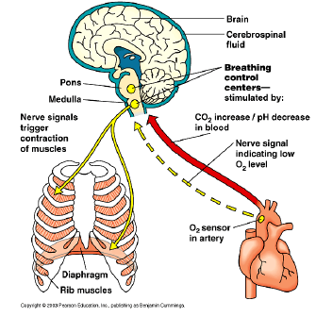

Slide 6
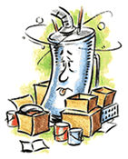
Why is carbon monoxide so dangerous?
It enters the bloodstream and robs oxygen from the blood cells.
The early effects of CO poisoning make you feel like you have the flu:
Headache
Upset stomach or vomiting
Light-headed
Very tired and achy all over
http://www.airinfonow.org/html/lungattack/lungplay.htm

Slide 7
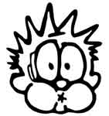
We can control it!
The thinking area of the brain can also
influence breathing, i.e. holding
your breath.
Drugs such as morphine and barbiturates make the CO₂ chemoreceptors less sensitive and therefore decrease the breathing rate.
too much drugs can slow down breathing to a point where life can not longer be sustained.

Slide 8
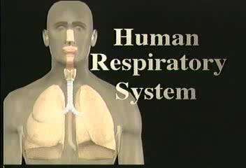

Slide 9
Response of the Respiratory System to Exercise
Ventilation of the alveoli can increase 20 times with heavy exercise to keep up with the demand for increased oxygen and CO2 removal.

Slide 10
Three factors that play a role in the lungs ventilation are:
Increased CO2, and increase H+, decreased O2

Slide 11
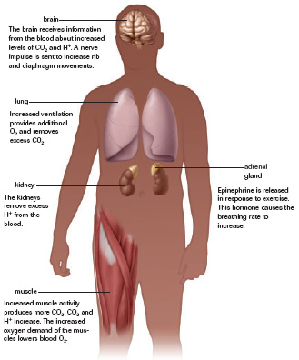
Body’s Response to Exercise

Slide 12
Disorders of the Respiratory System
All disorders decrease the oxygen delivery to the tissues, in your text read pages 294 - 296 and write at least two sentences describing the following;
Bronchitis
Bronchial Asthma
Emphysema
Lung Cancer
- answer questions 1-6 p 297

Slide 13
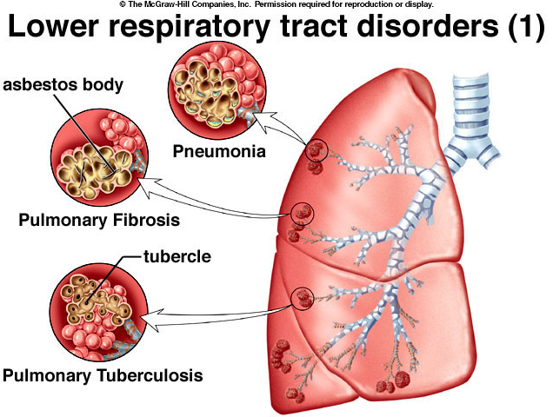
II.) Disorders of the Respiratory System
A. Bronchitis
Bacterial or viral infections
Reactions to environmental chemicals
Narrowing of air passages and inflammation of mucus lining in bronchial tubes
Mucous cells secrete more mucus
Tissues swell in bronchioles
As mucous secretions increase, air movement decreases
Bronchioles are not supported by bands of cartilage to help keep them open
Notes:
13

Slide 14
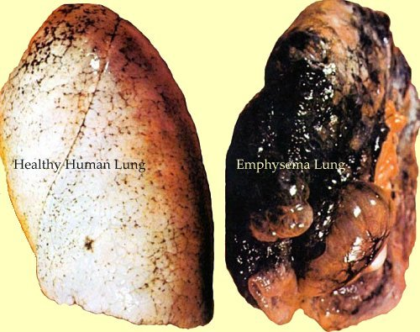
Emphysema
Emphysema is a
condition in which the
walls between the
alveoli within the lung
lose their ability to stretch
and recoil. The air sacs
become weakened and
break. Elasticity of the lung tissue is lost, causing air to be trapped in the air sacs and impairing the exchange of oxygen and carbon dioxide

Slide 15
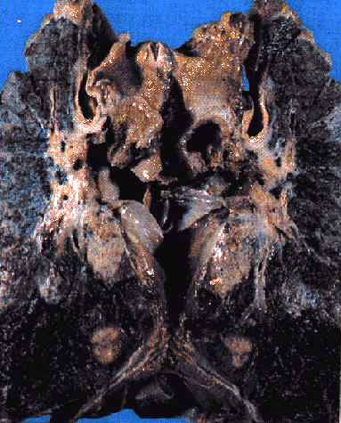
Lung Cancer
Lung cancer is the uncontrolled growth of abnormal cells in one or both of the lungs.
these abnormal cells reproduce rapidly and never grow into normal lung tissue.
Lumps of cancer cells (tumors) then form and disrupt the lung, making it difficult to function properly.

Slide 16
Lung Cancer
More Americans die each year from lung cancer than from breast, prostate, and colorectal cancers combined.
Approximately 173,770 new cases of lung cancer will be diagnosed in 2004, accounting for 13% of all new cancer cases.
An estimated 160,440 Americans will die in 2004 from lung cancer, accounting for 28% of all cancer deaths.
While overall cancer incidence rates are declining, lung cancer incidence rates among women continue to rise.

Slide 17
Asthma http://www.brainpop.com/health/diseasesandconditions/allergies
When asthma causes breathing problems, the person experiences an "asthma attack", or episode.
During an attack, three major changes can take place in the lungs:
Cells in the bronchioles make more mucus than normal. The mucus is thick and sticky and tends to clog up the bronchioles.
Cells in the airways get inflamed, causing the bronchioles to swell.
The muscles around them then tighten.
These changes cause the bronchioles to narrow and make it hard to breathe.

