Slide 1
Pancreas – Disorders
Biology 30

Slide 2
Pancreas
The pancreas is between the kidneys and the duodenum and provides digestive juices and endocrine functions.
Pancreatic Islets of Langerhans secrete:
- insulin, from the beta cells, which lowers the blood glucose level
- insulin makes cells more permeable to glucose
- glucagon, from the alpha cells, which increases the blood glucose level
- glucagon causes the conversion of glycogen to glucose
http://www.healthline.com/vpvideo/diabetes-how-insulin-works

Slide 3
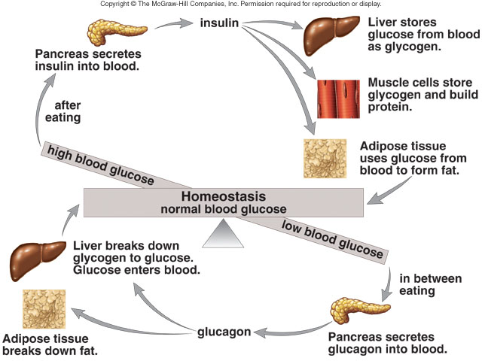
Regulation of blood glucose level
Notes:
(Top) When the blood glucose level is high, the pancreas secretes insulin. Insulin promotes the storage of glucose as glycogen and the synthesis of proteins and fats (as opposed to their use as energy sources). Therefore, insulin lowers the blood glucose level.
(Bottom) When the blood glucose level is low, the pancreas secretes glucagon. Glucagon acts opposite to insulin; therefore, glucagon raises the blood glucose level to normal.

Slide 4
Diabetes Mellitus:
Lack of insulin due to the failure of the pancreas to produce insulin or the inability of the body cells to take it up.
Hyperglycemia symptoms develop, and glucose appears in the urine.
Produce urine with sugar (kidneys are unable to reabsorb all the sugar)
High glucose concentration draws water from nephron by osmosis
Large volumes of urine, often thirsty

Slide 5
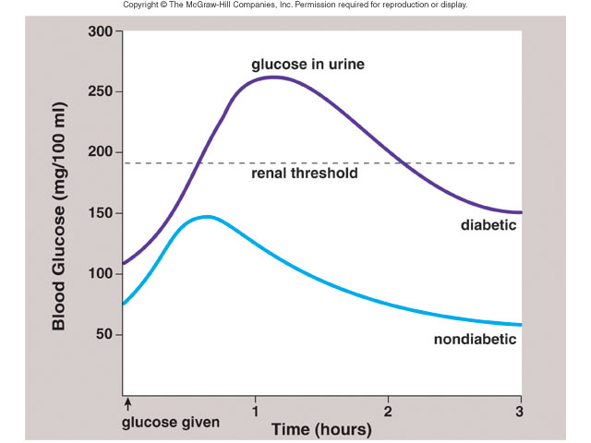
Glucose tolerance test
Notes:
Following the administration of 100 g of glucose, the blood glucose level rises dramatically in the diabetic but not in the nondiabetic. Glucose appears in the urine when its level exceeds 190 mg/100 ml (called the renal threshold).

Slide 6
3 types:
Juvenile onset: (by about age 6) ~10% of diabetes cases
Genetic
Treatment: insulin injections/pump
2) Maturity onset: diagnosed in adulthood ~90% of diabetes cases
Beta cells slow down production of insulin
Or, ineffective use of insulin by the body
Treatment: Diet & Exercise primarily
3) Gestational: Pregnant woman (2-4% of pregnancies)
Controlled by diet mostly
Increases the risk of both mother and child ending up with type II diabetes later in life

Slide 7
Type I diabetes mellitus occurs when the pancreas does not produce insulin and the patient requires insulin injections.
Most people with diabetes have Type II diabetes mellitus where the pancreas produces insulin but the body cells do not respond.
Both types lead to long-term serious complications.
Notes:
It is possible that up to 7 million Americans have type II diabetes without being aware of it.
Long-term complications of both types of diabetes are blindness, kidney disease, and circulatory disorders, including atherosclerosis, heart disease, stroke, and reduced circulation. The latter can lead to gangrene in the arms and legs. Pregnancy carries an increased risk of diabetic coma, and the child of a diabetic is somewhat more likely to be stillborn or die shortly after birth.

Slide 8
type I (insulin dependent) caused by lack of insulin production in pancreas, hereditary but may skip generations
treated with insulin injections and rigid blood monitoring
since insulin is a protein it would be digested if taken orally
must monitor both hypoglycemia (need glucagon or glucose) and hyperglycemia (need insulin)
in research: islet transplants, gene therapy (thought to have found gene)

Slide 9
type II (insulin independent), caused by decreased insulin production, or too much glucose produced by the liver (not enough compensation by pancreas), insulin resistance
gestational diabetes, during pregnancy, mother develops symptoms – at a greater risk for type II later in life
http://web.diabetes.org/link/link_for_life/main.html?loc=facts-about-type2

Slide 10
only type I requires daily insulin injections, type II and GDM are treated by changing diet & sometimes sulfonamides
symptoms of type I and II
fatigue (not enough glucose inside cells to provide an energy source – must use fat & protein)
excessive thirst & urination (glucose in urine pulls out water by osmosis)
increased appetite (& weight loss – type I)
increased susceptibility to infection
*** in type II, since it onsets slowly, there may be no symptoms initially
diabetes causes many complications due to fluctuations in blood sugar and ketoacidosis (products of fat breakdown which are toxic to the body), leads to acetone smell on the breath

Slide 11
Diabetes Incipidus – lack of ADH
Nothing to do with the pancreas!
Relationship is blood glucose levels because….
Lack of ADH causes you to lose lots of water
Therefore, your blood glucose concentration is higher
Constant thirst
Blood becomes hypertonic
Treatment: Take an antidiuretic drug

Slide 12
To Do:
Lab 15.A pg. 483 # 1- 8 (textbook)

