Slide 1
Adrenal Glands

Slide 2
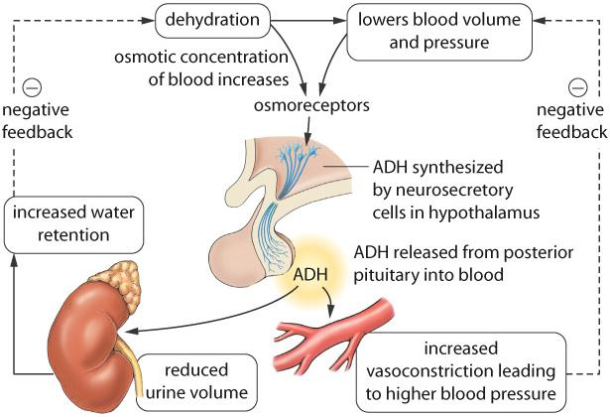
Posterior Pituitary
ADH is released when the blood plasma concentration is high (and blood pressure is low). ADH stimulates the kidneys to absorb more water, which dilutes the blood plasma (and increases blood pressure).

Slide 3
Adrenal Glands
Adrenal glands sit atop the kidneys and have an inner adrenal medulla and an outer adrenal cortex.
The hypothalamus uses ACTH-releasing hormone to control the anterior pituitary’s secretion of ACTH that stimulates the adrenal cortex.
The hypothalamus regulates the medulla by direct nerve impulses.

Slide 4
The adrenal medulla secretes epinephrine and norepinephrine, which bring about responses we associate with emergency situations.
On a long-term basis, the adrenal cortex produces glucocorticoids similar to cortisone and mineralocorticoids to regulate salt and water balance.
The adrenal cortex also secretes both male and female sex hormones in both sexes.
Notes:
Cortisone, the medication that is often administered for inflammation of joints, is a glucocorticoid.

Slide 5
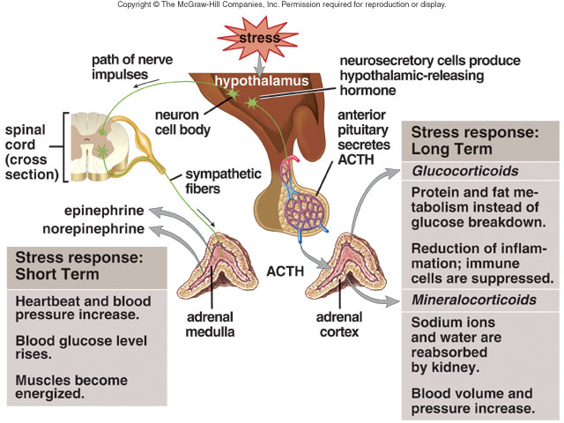
Adrenal glands
Notes:
Both the adrenal medulla and the adrenal cortex are under the control of the hypothalamus when they help us respond to stress. (Left) The adrenal medulla provides a rapid, but short-term, stress response. Effects include increased heartbeat and blood pressure, increased blood glucose, and energized muscles. (Right) The adrenal cortex provides a slower, but long-term, stress response. Glucocorticoid effects include protein and fat metabolism instead of glucose breakdown, reduction of inflammation, and a suppression of immune system cells. Mineralocorticoid effects include reabsorption of sodium ions and water by the kidneys, and increases in both blood volume and blood pressure.

Slide 6
Glucocorticoids
Cortisol promotes breakdown of muscle proteins to amino acids; the liver then breaks the amino acids into glucose.
Cortisol also promotes metabolism of fatty acids rather than carbohydrates, which spares glucose.
Both actions raise the blood glucose level.
High levels of blood glucocorticoids can suppress immune system function.

Slide 7
Mineralocorticoids
Aldosterone causes the kidneys to reabsorb sodium ions (Na⁺) and excrete potassium ions (K⁺).
When blood sodium levels and blood pressure are low, the kidneys secrete renin; the effect of the renin-angiotensin-aldosterone system is to raise blood pressure.

Slide 8
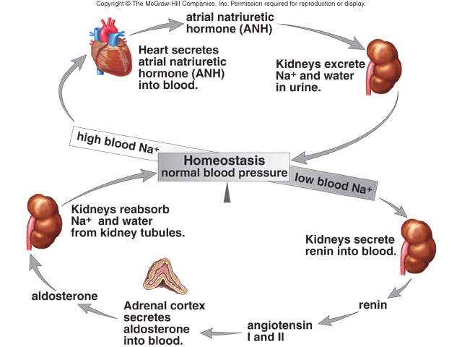
Regulation of blood pressure and volume
Notes:
(Bottom) When the blood sodium (Na⁺) level is low, a low blood pressure causes the kidneys to secrete renin. Renin leads to the secretion of aldosterone from the adrenal cortex. Aldosterone causes the kdneys to reabsorb Na⁺, and water follows, so that blood volume and pressure return to normal.
(Top) When the blood Na⁺ is high, a high blood volume causes the heart to secrete atrial natriuretic hormone (ANH). ANH causes the kidneys to excrete Na⁺, and water follows. The blood volume and pressure return to normal.

Slide 9
Malfunction of the Adrenal Cortex
Addison disease develops when the adrenal cortex hyposecretes hormones.
A bronzing of the skin follows low levels of cortisol, and mild infection can lead to death; aldosterone is also hyposecreted, and dehydration can result.
Cushing syndrome develops when the adrenal cortex hypersecretes cortisol.
The trunk and face become round; too much aldosterone results in fluid retention.
Notes:
A mild infection can lead to death due to lack of cortisol needed to replenish glucose levels.

Slide 10
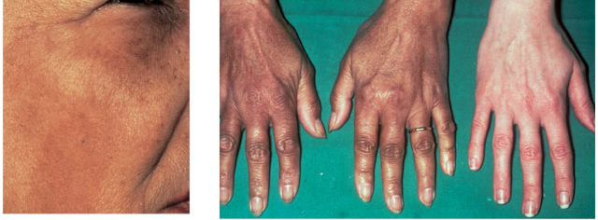
Addison disease
Notes:
Addison disease is characterized by a peculiar bronzing of the skin, particularly noticeable in these light-skinned individuals. Note the color of the face (left) and the hands compared to the hand of an individual without the disease.

Slide 11
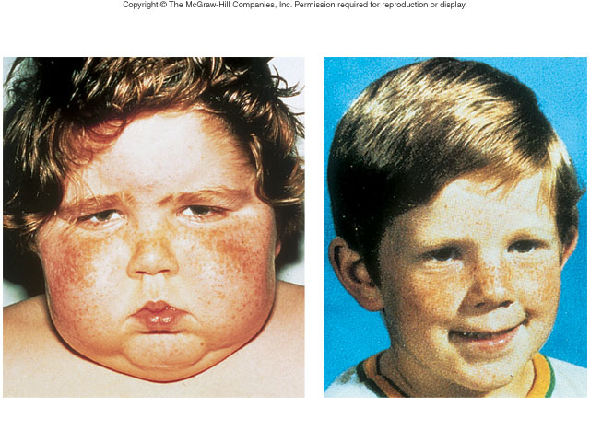
Cushing syndrome
Notes:
Cushing syndrome results from hypersecretion of hormones due to an adrenal cortex tumor. On the left, the patient as he appeared when first diagnosed with Cushing syndrome. On the right is the same patient, four months after therapy.

