Slide 1
20.3 DNA & Biotechnology
Biology 30

Slide 2
Definitions:
Genetic Transformation: introduction and expression of foreign DNA in a living organism
Recombinant DNA: fragment of DNA composed of sequences originating from at least 2 different sources

Slide 3
All cells have a group of enzymes called endonucleases
cut DNA
Bacteria – have special endonucleases called Restriction Enzymes

Slide 4
Restriction Enzymes (R.E.)
act like biological scissors that cut foreign DNA at specific recognition sites (4-8 base pairs, palindromes)
i.e., HANNAH
over 200 R.E.’s have been isolated
named for the bacteria they come from

Slide 5
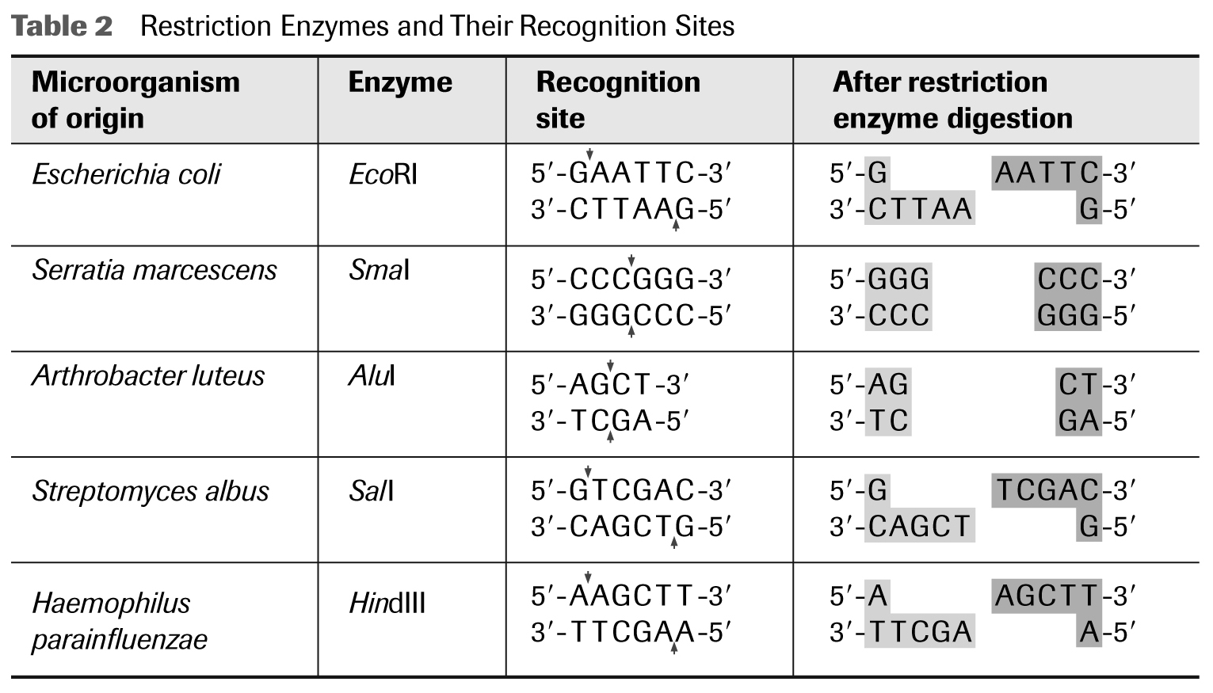
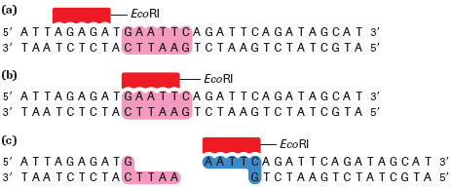
Recombinant DNA

Slide 6
The cut DNA has “sticky ends” (draw picture)
these sticky ends are now possible attachment sites for foreign DNA to be spliced in
Ligase acts like a “biological glue” that bonds foreign DNA to host DNA

Slide 7
Recombinant DNA

Slide 8
Example of use of R.E.’s
Insertion of insulin producing gene into bacteria cells

Slide 9
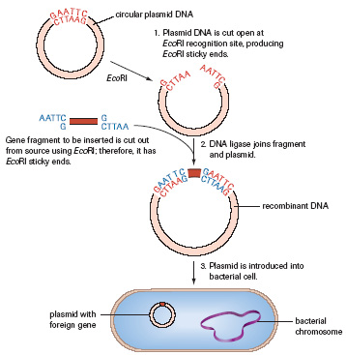
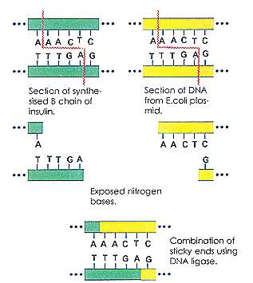
Recombinant DNA

Slide 10
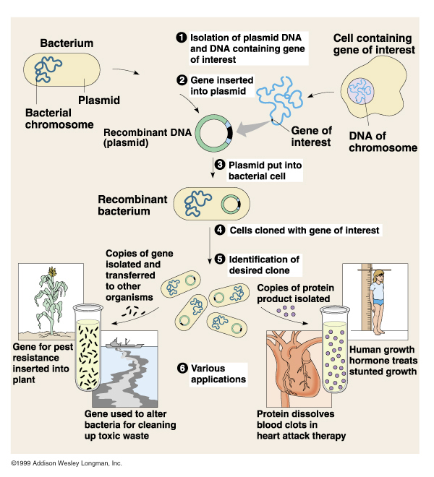

Slide 11
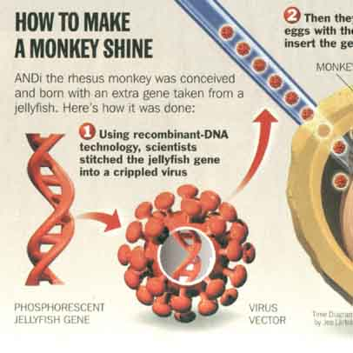
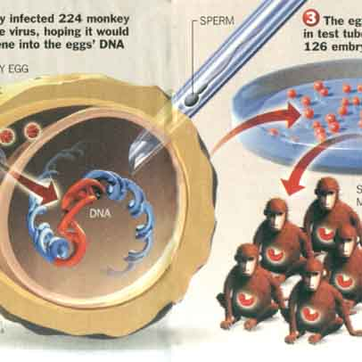
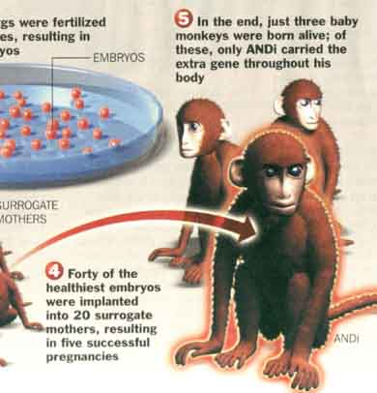
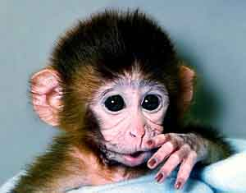
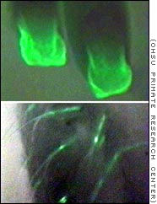
Transgenic Organisms
The fingernails
and hair follicles of two
other monkeys with the
flourescent gene glow
under ultraviolet light
ANDi (iDNA, injected DNA)

Slide 12
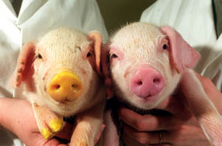
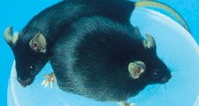
Jellyfish Gene
HGH

Slide 13
Methylases
enzyme that adds a methyl (-CH3) group to one nucleotide on a restriction enzyme recognition site
protects the gene fragment from being cut
in bacteria, methylases prevent digestion of DNA by it’s own R.E.’s
in Eukaryotic cells they occur to inactivate specific genes

Slide 14
Polymerase Chain Reaction (PCR)
Technique used to make billions of copies of DNA from extremely small quantities
taq polymerase + DNA to be copied + excess nucleotides (A, C, G, T) + primers in PCR machine
PCR machine cycles hot and cold
each cycle doubles the number of DNA molecules

Slide 15
PCR Steps (Figure 7 pg 682)
Mixture is heated to a high enough temperature to break the hydrogen bonds in the double helix and separate the strands. This forms single stranded templates
The mixture is cooled, and the primers form hydrogen bonds with the DNA templates.
Taq polymerase synthesizes a new strand of DNA from the template by complementary base pairings, starting at each primer
The cycling of heating and cooling is repeated many times

Slide 16
Polymerase Chain Reaction (PCR)
Video Clip
http://bio-rad.cnpg.com/lsca/videos/ScientistsForBetterPCR/

Slide 17
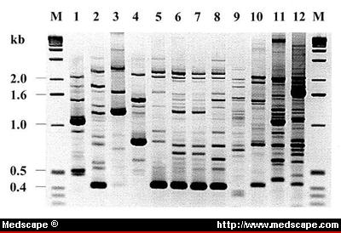
DNA Fingerprinting (gel electrophoresis)
Developed in 1975 by Sanger, Maxim & Gilbert
Use restriction enzymes to cut DNA into fragments of varying lengths

Slide 18
Steps:
Small sample of DNA
PCR to replicate DNA
R.E.’s cut DNA
place fragmented DNA on an agarose gel
run electrical current through gel
x-ray agarose gel = banding pattern

Slide 19
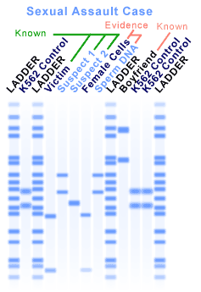
DNA Fingerprinting
Uses:
Criminal Activity
Paternity Testing

Slide 20
Human Genome Project
http://ed.ted.com/lessons/how-to-sequence-the-human-genome-mark-j-kiel

Slide 21
Human Genome Project
Race to determine the sequence of human DNA
timeline – table 1 page 678
published in 2001 and 2003
Know where & on what chromosomes specific genes are located.

Slide 24
Notes:
Scientists are busily sequencing the genomes of animals as well. They select which genomes to sequence based on many factors. Take dogs for example. Dogs share many diseases with humans, live in the same environments as people, come in wildly diverse breeds and often have well-documented pedigrees. Different dog breeds are being sequenced such as the poodle and the boxer. Genome Alberta and the University of Alberta have been involved with the sequencing of the Bos taurus (cow).

Slide 26
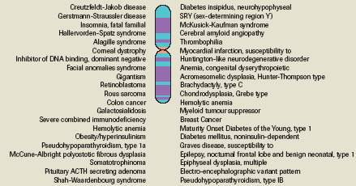
Human Chromosome #21

Slide 27
Gene Therapy: Possibility of replacing faulty genes
i.e., hemophilia, cystic fibrosis, sickle cell anemia, huntingtons disease, tay-saches disease
Must be preformed on an embryo
being done on viruses
vector – way of transporting DNA to cell

Slide 28
Gene Therapy
i.e., Bacterial
oil spill clean up
mineral processing
agriculture – frost resistant tomatoes
http://www.fastcompany.com/3002700/dna-hacking-now-street-legal?utm_source=feedburner&utm_medium=feed&utm_campaign=Feed%3A+fastcompany%2Fheadlines+%28Fast+Company%29

Slide 29
Personal DNA Testing
Video Link
http://www.pbs.org/wgbh/nova/sciencenow/0302/01.html

