Slide 1
20.2 Gene Expression & Protein Synthesis
Biology 30

Slide 10
Protein Synthesis
The way information in a gene is converted into a specific characteristic or trait is called gene expression.
Diagram:

Slide 11
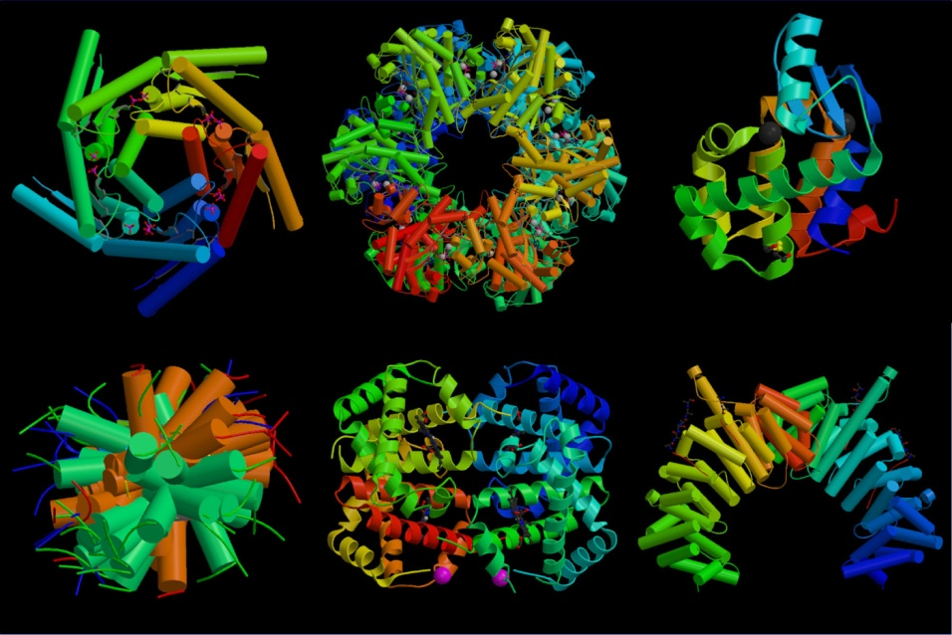
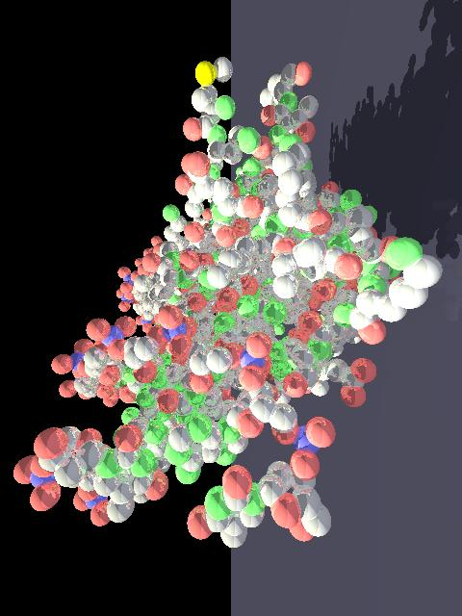
Protein:
A long chain of amino acids
Every protein has to be coded for in DNA
The function of a protein is dependent on its shape
Uses: muscle, enzymes, hormones, cell membrane, etc

Slide 12
The Central Dogma:
2 main stages: Transcription & Translation
Diagram:

Slide 13
RNA – ribonucleic acid
Different sugar (ribose sugar)
Single stranded
Thymine is replaced by uracil
A pairs with U
G pairs with C

Slide 14
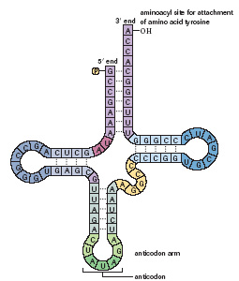
Types of RNA:
mRNA: messenger – takes code from nucleus to cytoplasm; single stranded
tRNA: transfer – carries specific amino acids to the ribosome (20 different tRNA molecules, each specific to an a.a.)
mRNA codon: a triplet of nucleic acids (nucleotides)

Slide 15
Transcription:
Initiation – RNA polymerase binds to DNA at a specific site near the beginning of a gene (promoter – sequence of A & T)

Slide 16
2) Elongation – RNA polymerase builds single-stranded RNA in a 5’ to 3’ direction
Transcribed DNA strand = template strand
diagram

Slide 17
Termination – synthesis of mRNA continues until a termination sequences is reached then mRNA disconnects
mRNA moves to cytoplasm

Slide 18
To Do:
Practice Q’s pg. 669 #1 & 2
Transcription animation

Slide 19
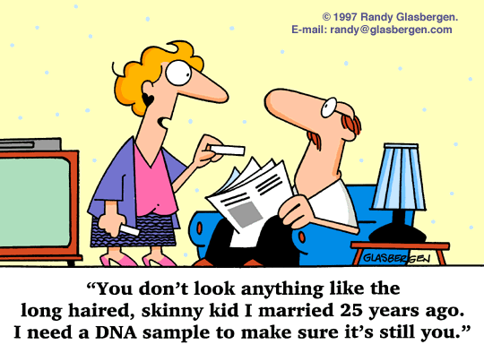

Slide 20
Translation (protein synthesis):
20 different amino acids (a.a.’s) make up proteins (table 2, pg. 671)
Essential | Nonessential
Isoleucine | Alanine
Leucine | Asparagine
Lysine | Aspartate
Methionine | Cysteine*
Phenylalanine | Glutamate
Threonine | Glutamine*
Tryptophan | Glycine*
Valine | Proline*
 | Serine*
 | Tyrosine*
 | Arginine*
 | Histidine*

Slide 21
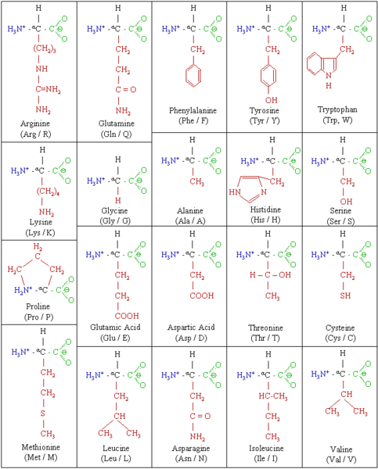

Slide 22
Translation continued…
mRNA code is read in groups of three nucleotides = codon
4³ = 64 possibilities
See table in data booklet or text pg. 670
AUG = start codon = methionine
Stop codons: UAA, UAG, UGA

Slide 23
Triplet Code
A codon is made of 3 mRNA nucleotides
64 codons total
Codon (AUG) encodes methionine and starts translation of all proteins
61 codons encode
20 amino acids
(redundant code)
3 codons stop
protein translation
AUG
GCA
UAA
UAG
UGA
Methionine
Alanine
Notes:
The translation of base sequences from DNA to protein is dependent on the nucleotide triplet in mRNA. Each mRNA triplet of nucleotides, called a codon, codes for a single amino acid, and, ultimately, a string of amino acids makes up a protein. Since the complementary DNA that specifies a particular mRNA has only four nucleotide bases in a gene, 64 (4X4X4) possible combinations of codons are available to code for 20 amino acids. So there is great redundancy. There are 60 mRNA triplets for 19 amino acids, 3 triplets for “stop,” and 1 triplet to call for methionine, the 20th amino acid that signals “start.” Most amino acids are coded for by more than one triplet codon. However, each triplet is linked to only one amino acid. (For more information on how genes build proteins, please see Genetic Variation.)

Slide 24
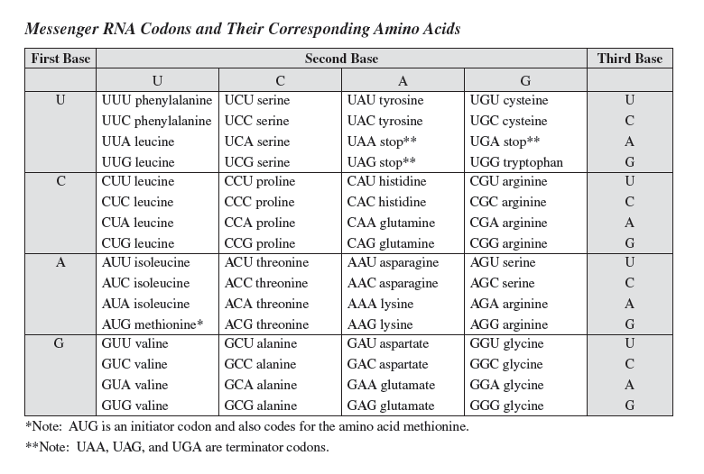

Slide 25
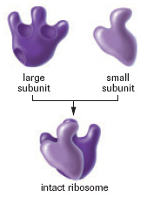
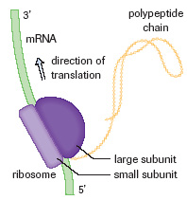
Initiation:
a ribosome binds to mRNA
2 subunits clamp mRNA between it
Ribosome moves in a 5’ to 3’ direction until it finds a start codon

Slide 26
My drawn diagram….

Slide 27
2) Elongation:
tRNA with complementary to start codon attaches to mRNA
Next in line enters the next site
Peptide bond forms between two a.a’s
Ribosome shifts over one codon

Slide 28
3) Termination:
when a stop codon is reached the ribosome - mRNA complex breaks apart, releasing the polypeptide chain
Translation Animation

Slide 29
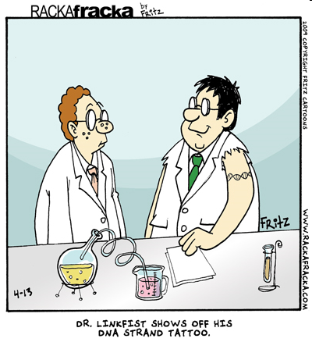

Slide 30
Transcription & Translation Review: Worksheet
DNA #1 | ACA
DNA #2
m-RNA
t-RNA
Amino Acid |  | tryptophan

Slide 31
To Do: due tomorrow!
Worksheet: Transcription and Translation Review
Do #1, 2 and #5 first
The rest of the questions can be extra practice if you want
2 DNA “Sentences”
Pg 671# 3-5
Lab 20.A pg. 674 – omit analysis question (g)

