Slide 1
Mutations & Genetic Variation
Biology 30: Molecular Genetics

Slide 2
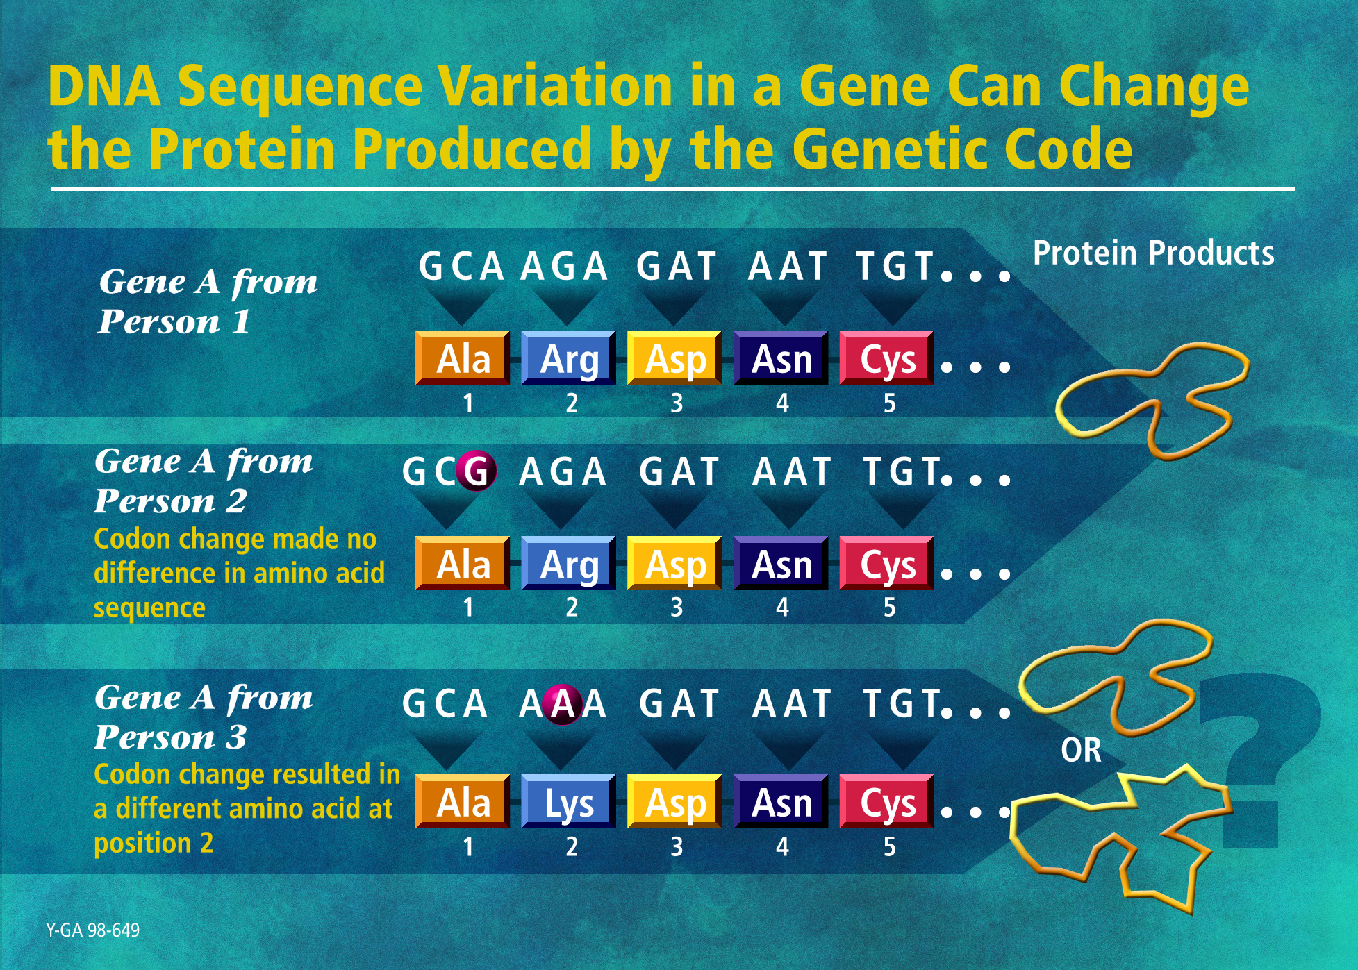

Slide 3
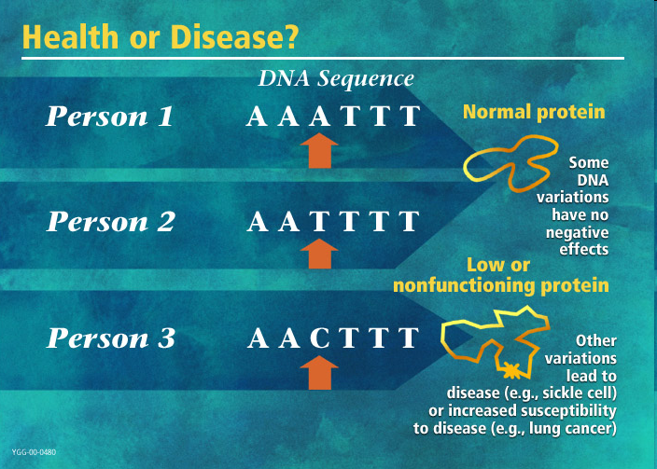

Slide 4
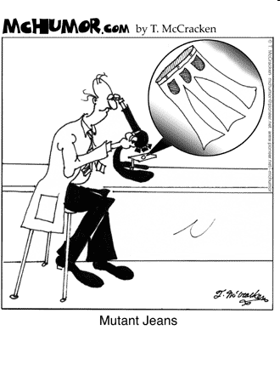

Slide 5
Silent Mutation
Does not result in a change for the amino acid (a.a.) coded for
Example:

Slide 6
Missense Mutation
Results in the single substitution of one a.a. in the polypeptide
Example:

Slide 7
Nonsense Mutation
Converts a codon for an a.a. into a stop codon
Example:

Slide 8
Deletion
Elimination of base pair or group of base pairs in DNA sequence
Example:

Slide 9
Insertion
Placement of an extra nucleotide in a DNA sequence
Example:

Slide 10
Frameshift Mutation
Mutation that causes the reading frame of Codons to change (insertion of deletion of any # but 3 nucleotides)
Example:

Slide 11
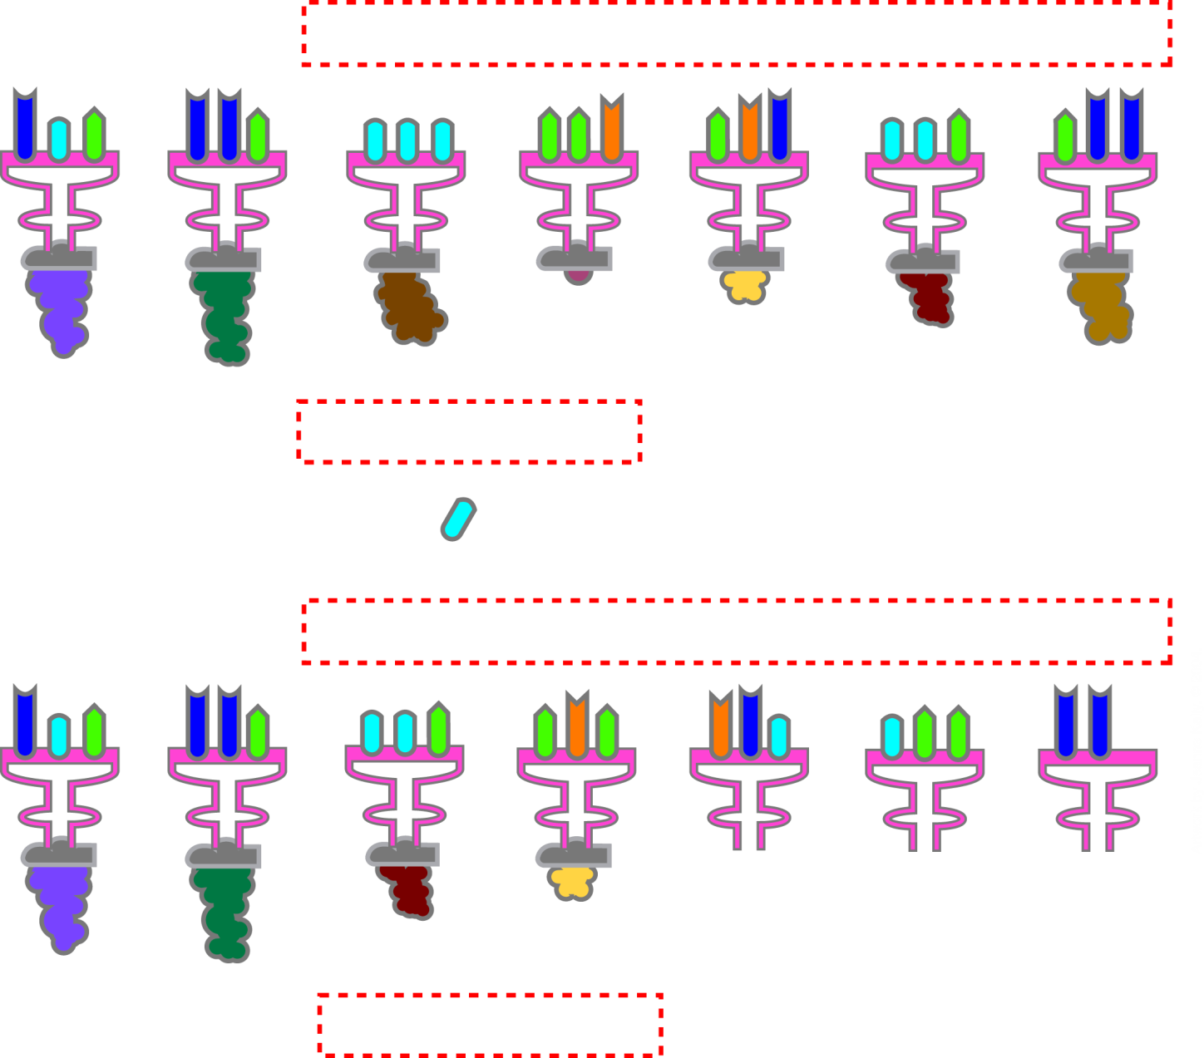
Frameshift Mutations
Normal
A
U
G
A
A
G
U
U
U
G
G
C
G
C
A
U
U
G
G
A
A
tRNA
Protein
Methionine
Lysine
Phenylalanine
Glycine
Alanine
Leucine
Glutamine
U
Frameshift
A
U
G
A
A
G
U
U
G
G
C
G
C
A
U
U
G
G
A
A
tRNA
Protein
Methionine
Lysine
Leucine
Alanine
Notes:
Another type of mutation that can occur is a frameshift mutation. When a gene is copied, the action begins in the nucleus. There an mRNA strand copies the DNA strand exactly. It codes for a protein precisely, leaving no gaps or spaces separating the triplets. This set of connected triplets is called the reading frame. A frameshift mutation is caused by the addition or loss of a nucleotide, or nucleotides. This alters the content of every triplet codon that follows in a reading frame. Frameshift mutations usually result in a shortened abnormal or nonfunctional protein, and they can create an early STOP codon downstream. If the number of added or missing base pairs is a multiple of three, the resulting protein may be drastically altered, and its function will depend on the extent of these alterations.

Slide 12
Translocation
Transfer of a fragment of DNA from one site in the genome to another location

Slide 13
Inversion
Reversal of a segment of DNA within a chromosome

Slide 14
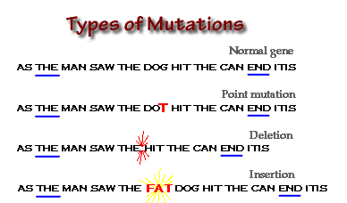
Protein Synthesis
Translocation: MAN AS THE SAW THE DOG HIT….

Slide 15
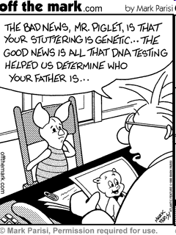

Slide 16
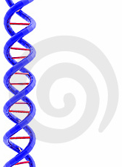
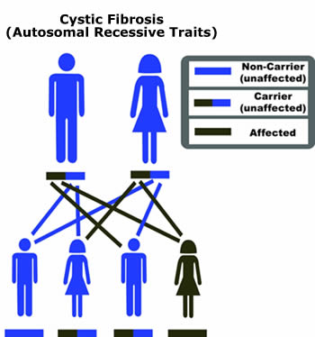
DNA Sequence Analysis: Cystic Fibrosis
The most common fatal autosomal recessive genetic disorder of Caucasian children
Symptoms: breathing difficulties, constant cough, excessive appetite with weight loss, salty skin, recurrent pneumonia, failure to thirve

Slide 17
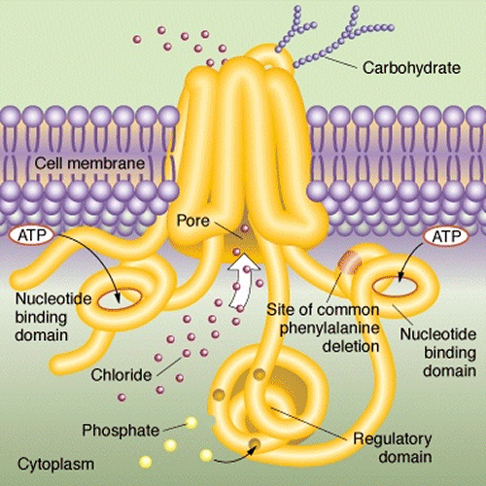
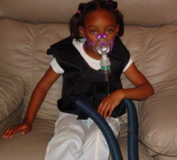
Cystic Fibrosis
Disease incidence ~ 1/3,300
Carrier frequency ~ 1/25
CFTR (7q31), 24 exons spanning ~ 250 kb, ~ 6.5kb transcript
ΔF508 found in ~ 70%
Currently more than 1,000 different mutations identified
CFTR protein: chloride ion
channel important in creating
sweat, digestive juices, and
mucus

Slide 18
Dynamic Mutations: Fragile X Syndrome
Symptoms: moderate mental retardation, long face, large ears, prominent jaw, autistic behaviours
Prevalence of ~1/4,000
FMR1 gene (Xq27.3): 17 exons spanning 38 kb, coding for RNA-binding protein
> 98% of cases result from CGG expansion in 5’ UTR and reduced FMR1 expression

Slide 19
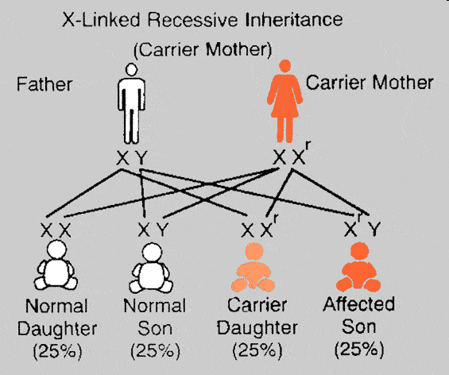
X-linked Inheritance

Slide 20
Fragile X Repeat Size Range
CGG
CGG
CGG
CGG
CGG
CGG
CGG
CGG
Normal: ~5 – 44 repeats
Intermediate: ~45 – 54 repeats (possible expansion in future generations)
Premutation: ~55 – 200 repeats (high risk of expansion)
Full mutation: >200 repeats (symptomatic)

Slide 21
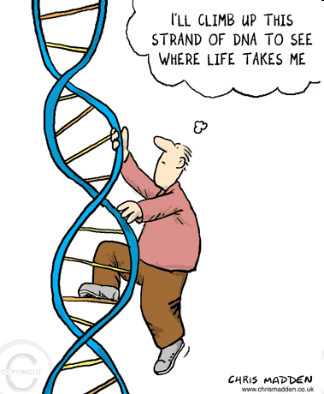

Slide 22
Also need to know:
What causes mutations?
Mitochondrial and Chloroplast DNA – what is the significance?
Mitochondrial DNA

Slide 23
Gene Regulation
Cancer = uncontrolled cell growth
Oncogenes:
  Stimulate cell division
  Under normal circumstances oncogenes are regulated so that cell division is controlled

Slide 24
regulator
gene
oncogene
Produces
Regulator
protein
Binds protein
to oncogene
(turns off)

Slide 25
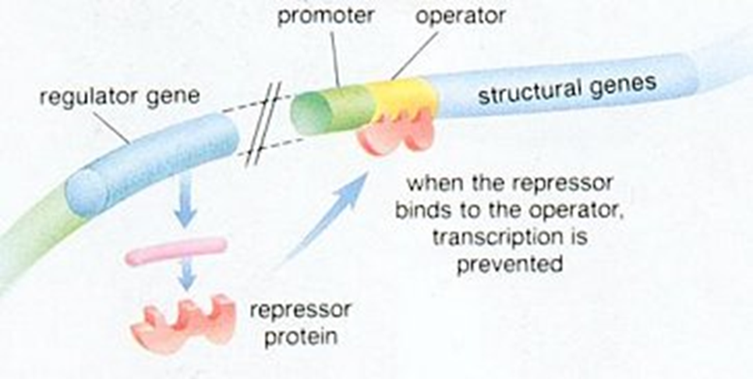

Slide 26
Cancer:
Mutation of the regulator gene
Movement of the regulator gene

Slide 27
Cancer cells differ from normal cells…
They divide more quickly
Do not adhere to one quickly
Move throughout the body (metastasis)
Have no function

Slide 28
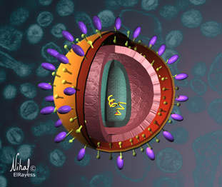
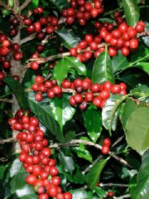
Mutations lead to genetic diversity!
Viruses like HIV mutate very quickly. The mutations cause physical differences in the virus. This is why it is very hard to create antiviral medication…because the virus is always changing faster than the medication can be developed!
Several coffee plants have been developed in nature because of polyploidy – a mutation where the embryo has double the number of chromosomes it should! Rather than die, the embryo develops into a new species of plant!

Slide 29


Random mutations lead to genetic diversity!
Random mutation Here!
Who else will have
the mutation?

Slide 30
Mutations Provide Genetic Diversity!
Imagine one mutation shows up, all the offspring will have that mutation as well.
Imagine over thousands of generations, how many mutations have occurred!
We can use the pattern of mutation inheritance to trace family ancestry!
The closer the relation between two people, the greater the similarity in DNA sequences!
The genetic difference between one person and another is less than 0.1 %

Slide 31
Protein Synthesis
Mutations Provide Genetic Diversity!
The DNA that we test for family relations (such as paternity testing) comes from more than just the nucleus of the cell (although we do test DNA from the nucleus).
CHLOROPLASTS and MITOCHONDRIA also contain DNA!!!
In humans, we can sequence mitochondrial DNA to analyze the maternal family line of an individual.

Slide 32
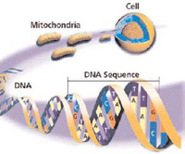
Protein Synthesis
Mutations Provide Genetic Diversity!
Mother’s mitochondria are located in each egg.
So mother’s pass on mitochondrial DNA to each of her offspring.
When a mother gains a mutation in her mtDNA, she passes it on to her offspring.

Slide 33
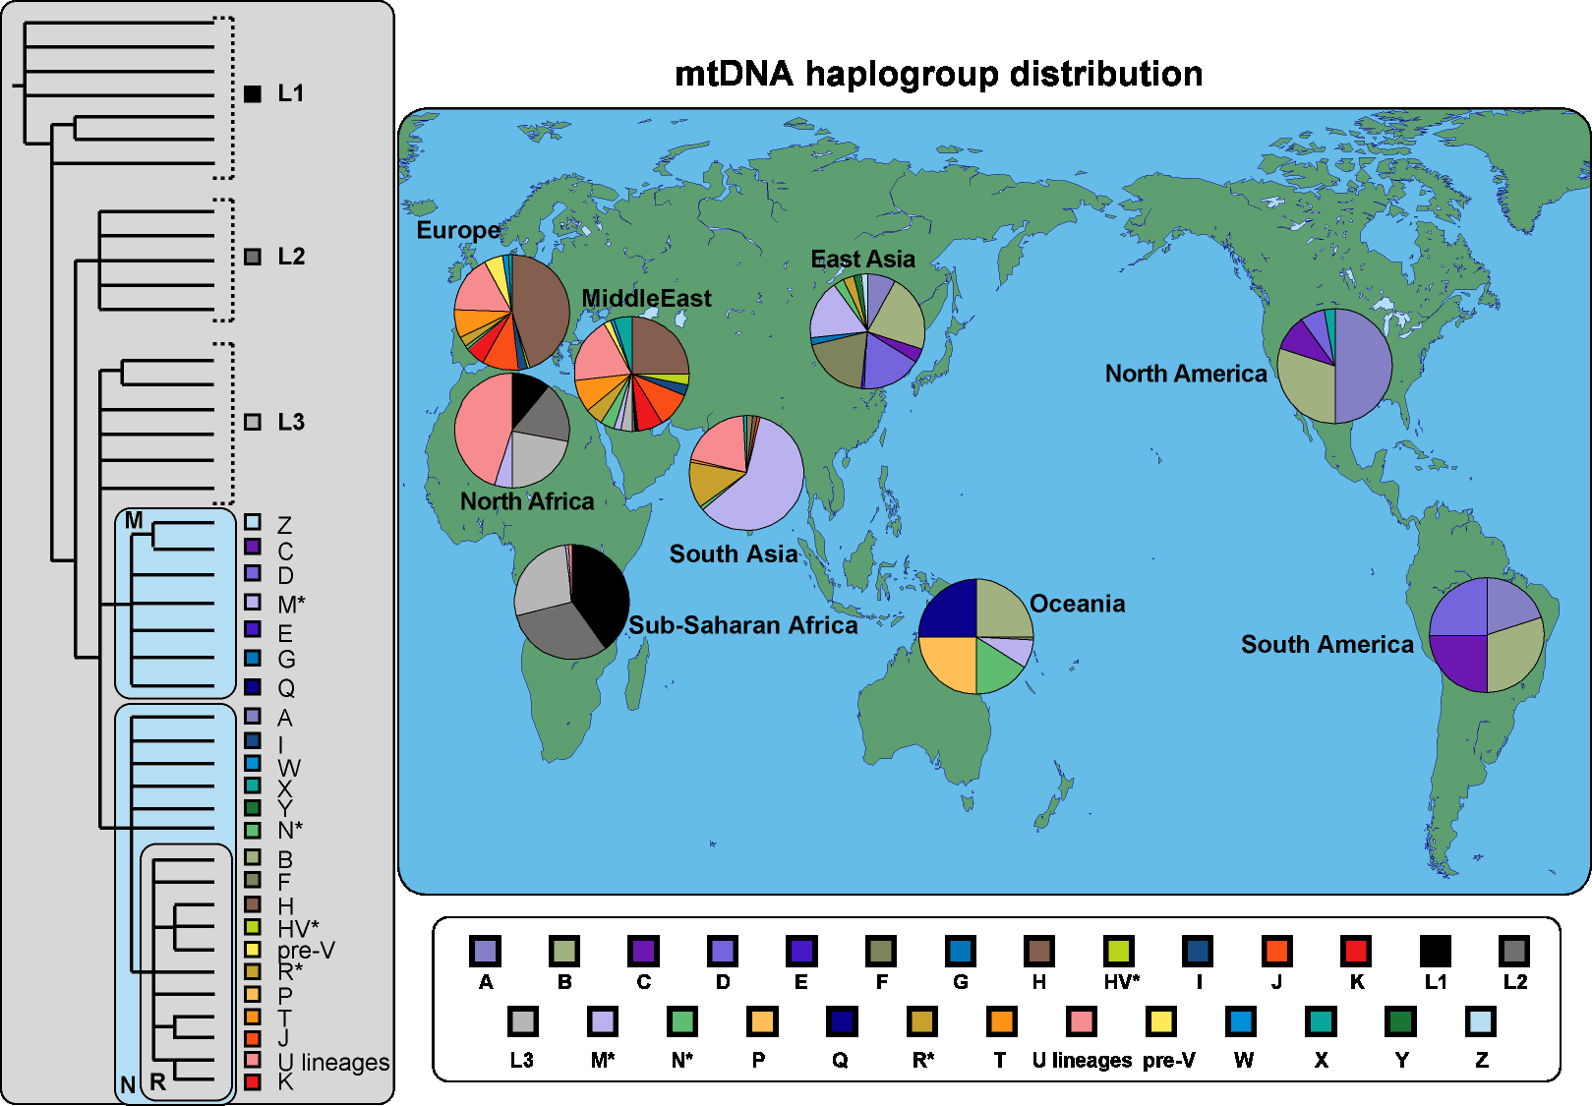
Protein Synthesis

Slide 34
DNA fingerprinting
DNA fingerprinting is used to compare DNA samples from different locations.
It can be used to match parents to children and it can be used to match blood stains at a crime scene to a suspect.
The more similar the pattern, the closer the two samples are related!
NOTE: DNA FINGERPRINTING WORKS BECAUSE EACH PERSON HAS A DIFFERENT NUMBER OF RESTRICTION FRAGMENT LENGTH POLYMORPHISMS (RFLP) THAT SHOW UP IN THE FINGERPRINT.

Slide 35
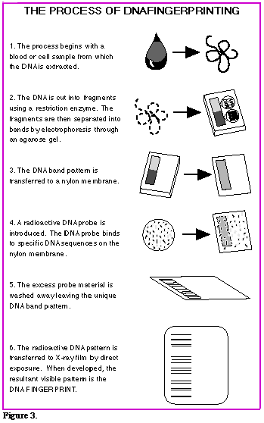
DNA fingerprinting procedure
Collection of sample
Cut DNA with restriction enzymes
Separate DNA segments use gel electrophoresis
Blot DNA segments onto paper
Put radioactive probe on the paper with DNA segments
Take a look using x-ray film!
Check out electrophoresis

