Slide 1
Sex Linked Traits
Biology 30

Slide 2
Sex Determination
Sex Chromosomes: Most organisms have two sex chromosomes
i.e., XX or XY
Determined how sex determination occurs. Principal of sex linked traits.

Slide 3
Human’s and Applied Genetics
Problem: Studying human genetics
controlled matings
huge variation
life span
limited #’s of offspring

Slide 4
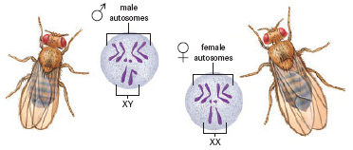
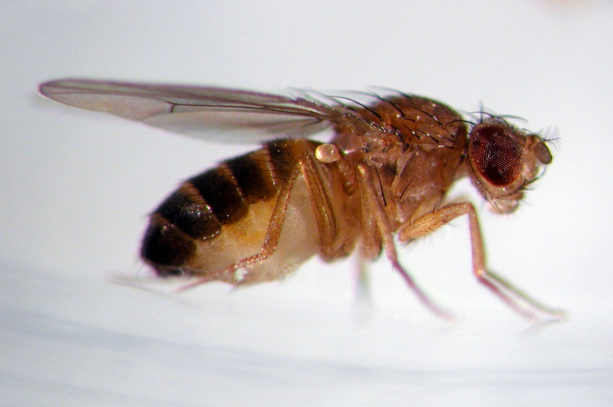
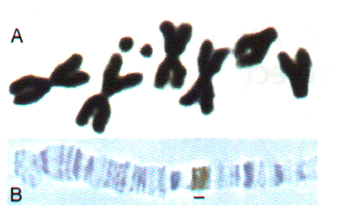
Thomas Morgan – Drosophalia Malanogaster
Studied Fruit Flies:
Large #’s
Can control matings
Small
Giant chromosomes

Slide 5
Sex Linked Traits
Different genes found only on the X Chromosome
i.e., Eye color in Drosophila
X^{R} = red eyes
X^{r} = white eyes

Slide 6
Example:
Cross X^{R}X^{r} with X^{r}Y
Report Phenotypes by sex
i.e., 100% of the females have brown bodies and 100% of the males have black bodies

Slide 7
Recessive Lethal
A trait that, when both recessive alleles are present results in death or severe malformation of the offspring
Usually recessive traits occur more frequently in males
WHY???

Slide 8
Carrier Females
Show the dominant phenotype, but “carry” the recessive allele.
i.e., heterozygous
X^{R}X^{r}

Slide 9
Barr Bodies
In somatic cells of females one X chromosome becomes inacative (random)
Dark spot seen on microscope slide is called a Barr Body after Dr. Murray Barr, it’s discoverer.
Therefore, not all female cells are identical, some express different traits

Slide 10
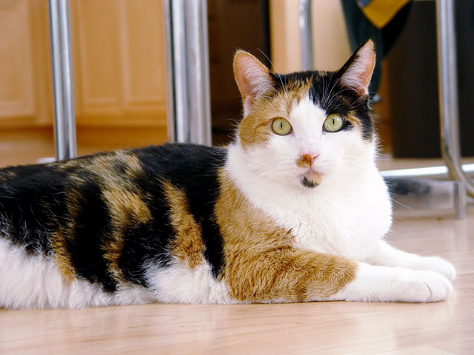
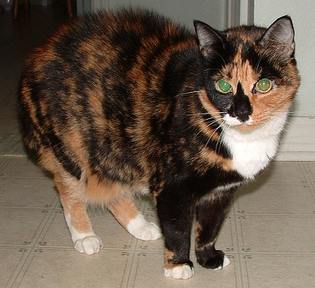
Examples:
In Humans:
Skin Disorder – some patches of skin contain sweat glands, some patches do not.
Calico Cats – incomplete dominance in alleles for yellow and black fur

Slide 11
To Do:
Read pages 629-631 in your textbook
Genetics Worksheet #5 – Sex Linked Traits

