Slide 1
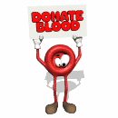
Blood and Immunity

Slide 2
Blood
Although blood appears to be a thick, homogenous solution, the microscope reveals that it has both cellular and liquid components
Blood is a specialized type of connective tissue in which living blood cells are suspended in a non living matrix called plasma

Slide 3
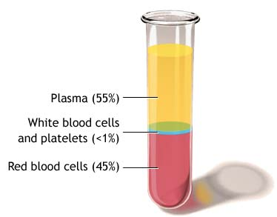
Components of Blood
Blood is broken into 3 main components
55% fluid called plasma (it is approximately 90% water, 10% blood proteins (albumins, globulins, fibrionogens), glucose, vitamins, minerals, dissolved gases, and waste products
less than 1% white blood cells
45% red blood cells

Slide 4
Plasma Proteins
Your plasma also contains three important proteins
Albumins- controls osmotic balance
Globulins - makes antibodies for protection
Fibrinogen - control blood clotting

Slide 5
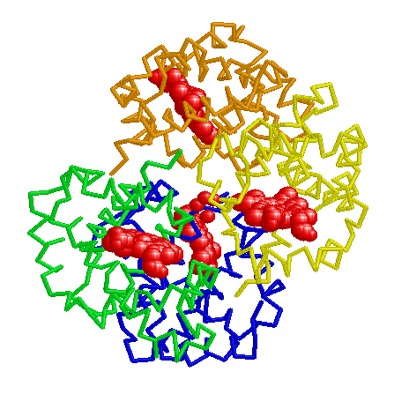
Erythrocytes
Erythrocytes (red blood cells) are small, round biconcave cells whose primary function is the transportation of oxygen.
Erythrocytes have iron containing pigments called hemoglobin which increases the capacity of blood to carry oxygen

Slide 6
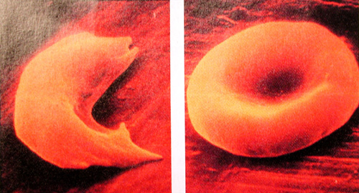
Erythrocyctes are also enucleated (they have no nucleus) and as a result do not have to carry out cellular functions
Erythrocytes are replaced by the bone marrow approximately every 120-130 days

Slide 7
Leucocytes White Blood Cells
White Blood Cells (WBC) are defenders against bacteria, viruses, and foreign substances of any kind. They are killed to make pus
New white blood cells are formed in the bone marrow

Slide 8
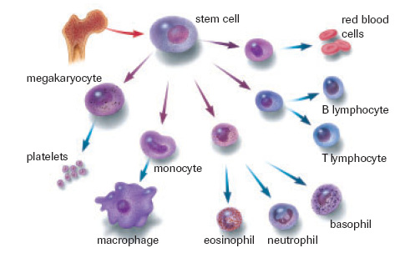
WBC’s
There are five main types of white blood cells
neutrophils- general granulocyte
monocytes- make macrophages to engulf invaders
esinophils- granulocyte which kills parasites
basophils- granulocyte which releases histamines
lymphocytes- make B and T cells
ALL HELP IN THE FIGHT AGAINST DISEASE

Slide 9
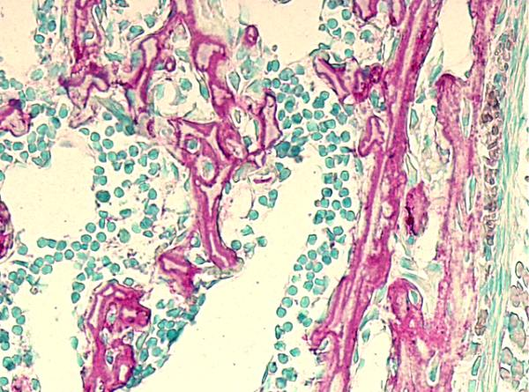
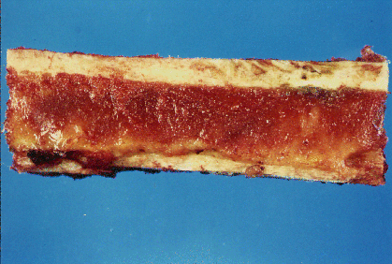
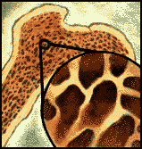
BONE MARROW

Slide 11
Platelets
Platelets are cytoplasmic fragments that break off from unusually large cells found in the bone marrow
They play an essential role in the clotting of blood and in plugging breaks in blood vessels

Slide 12
Textbook questions
Do #1-6 on page 352

Slide 13
The Functions of Blood
Blood is the most abundant fluid in our bodies. It does a number of jobs to keep us healthy and strong including distribution of substances throughout our bodies, regulation of blood levels and body protection

Slide 14
Distribution
Delivering oxygen from the lungs and nutrients from the digestive tract to all body cells
Transporting metabolic waste products from cells to elimination sites
Transporting hormones from the endocrine organs to their target organs

Slide 15
Regulation
Maintain appropriate body temperature by vasoconstriction and vasodialiation
Maintain normal pH in body tissues
blood proteins act as buffers
reservoir of bicarbonate ions
Maintain adequate fluid volume in the circulatory system
salts and blood proteins prevent excess fluid loss

Slide 16
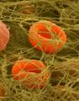
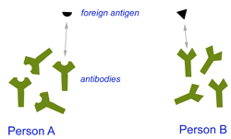
PROTECTION
1. protects our bodies against excessive blood loss (clotting and spasms)
2. protection against foreign invaders through the lines of defense of the immune systems white blood cells (WCB) and antibodies

Slide 17
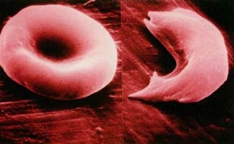
Blood Disorders
Anemia- A condition where the blood has an abnormally low oxygen carrying ability
Causes include
insufficient # RBC
decreased hemoglobin (no iron→ hemoglobin→ RBC)
abnormal hemoglobin (ie: Sickle cell anemia)

Slide 18
Leukemia
Refers to a group of cancerous conditions of white blood cells which remain unspecialized and mitotic, and suppress or impair normal bone marrow functioning
WBC have developed too quickly and cannot carry out functions properly
They use resources needed by healthy cells

Slide 19
Hemophilia
do not have proper proteins for clotting
increased occurrence in males
simple injuries can be fatal, need to be treated with transfusion or clotting agents
many contracted AIDS when there were improper screening practices in place

Slide 20
Blood and Immunity
Clotting
Blood Types
Rh Factor

Slide 21
Blood Clotting
Blood clotting maintains homeostasis by preventing the loss of blood from torn or ruptured blood vessels. They also provide additional support to weakened blood vessels that have been injured so they do not rupture

Slide 22
Blood Clotting
When you are injured often the vessel is torn and jagged. Platelets will catch on the jagged edges and rupture.
When platelets rupture they release thromboplastin
Thromboplastin will, along with plasma factors like calcium, activate prothrombin, a plasma protein
Prothrombin will then be transformed into thrombin

Slide 23
Thrombin then will act as an enzyme and will splice two amino acids from the fibrinogen molecule creating fibrin.
Fibrin is very fine threads that will wrap around the damaged area, sticking to it and to each other sealing the skin with a clot.
This clot blocks microbes but allows WBC’s to gain access

Slide 25
Problem
Why does getting cut with a sharp knife hurt less but always bleed more than getting cut with a dull knife?
Solution:
Because when you cut yourself with a sharp knife, there are clean edges to the cut and the platelets have nothing to snag on. Bleeding occurs for longer but hurts less because there is no rough tearing of vessels

Slide 26
Problems with Clotting
Sometimes clots can seal blood vessels. This blockage, called a thrombus, will prevent local tissues from getting oxygen and nutrients
If a clot should dislodge it becomes an embolus. This may become lodged in vital organs
blockages in the brain (cerebral) will cause stroke
blockages in the heart (coronary) will cause heart attack

Slide 27
Blood Groups
Jean Baptiste Denis was the first to perform a blood transfusion. He injected lamb blood into a young boy successfully. A repeat experiment on an older man proved disastrous though, the man died almost immediately.
He lacked the crucial information that there are different blood groups

Slide 28
Blood Typing
Karl Landsteiner discovered the secret to transfusions. There are special markers (glycoproteins/antigens) found on the membrane of the red blood cells
The blood contains antibodies that recognize antigen surface markers on RBC’s

Slide 29
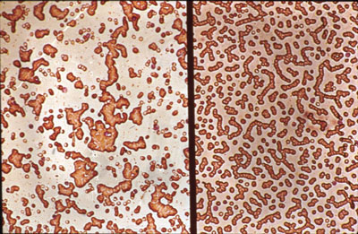
If two incompatible blood types are mixed during a transfusion, the antibodies cause the cells with the ‘wrong’ surface markers to clump together= agglutination

Slide 30
ABO Blood Typing
Type A blood has A markers and B antibodies
Type B blood has B markers and A antibodies
Type AB blood has A and B markers and no antibodies (universal recipient)
Type O blood has neither A or B markers but both A and B antibodies (universal donor)

Slide 31
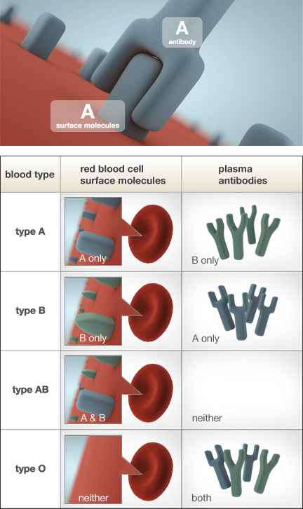

Slide 32
ABO Blood Groups
 | Antigen | Antibody | Donate To | Receive From
A |  |  | A, AB, | A, O
B |  |  | B, AB | B, O
AB |  | none | AB | A,B, AB, O
O |  |  | A, B, AB,O | O

Slide 33
Agglutination Response

Slide 34
Blood Type Frequencies
 | Af Am | Cau | As | Am In | Chin
A | 27 | 41 | 28 | 8 | 25
B | 20 | 9 | 27 | 1 | 35
AB | 4 | 3 | 5 | 0 | 10
O | 49 | 47 | 40 | 92 | 30

Slide 35
Rh Factor
The rhesus (Rh) factor is another marker (antigen) that is found on your blood.
If you are Rh+, your blood cells have the Rh marker and you DO NOT MAKE antibodies against yourself
If you are Rh-, your immune system will treat the Rh marker as foreign and produce Rh antibodies

Slide 36
Rh Pregnancy Problems
A mother with Rh- blood is at risk in her second pregnancy if her first child is Rh+
The first child produces cells with the Rh marker which mingle with the mother’s blood during the trauma of birth.
The mother’s immune system produces antibodies against the Rh marker
1st baby is OK because they are born by this time

Slide 37
If the second fetus is Rh+, the mother’s antibodies will attack the child’s red blood cells
These antibodies can cross the placenta, whereas the antibodies for blood types cannot
Mothers are given a shot Rh antibodies (rhogam) after a Rh+ birth to help out

Slide 38
If the mother is not given this shot, erythroblastosis fetalis (blue baby) can occur.
This is the death of the fetus
blood is being occupied in clumps
oxygen cannot circulate in baby’s body
baby will suffocate in utero
born stillborn/spontaneous abortion

Slide 39
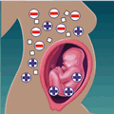
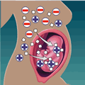
Rh Factor During Pregancy

Slide 40
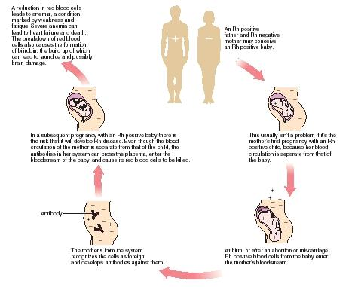

Slide 41
Blood Groups Activity
http://www.wisc-online.com/objects/index_tj.asp?objID=AP14804

Slide 42
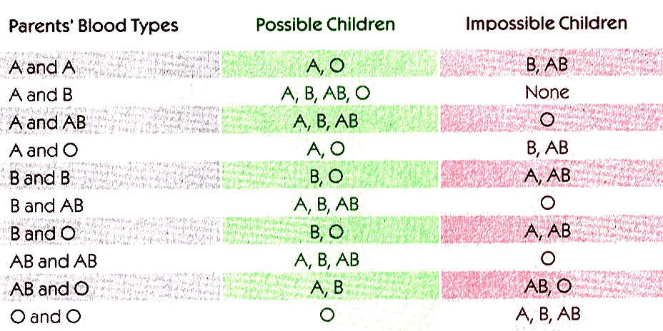
Textbook Questions
Do questions #7-9 and 15-18 pg. 356

