Slide 1
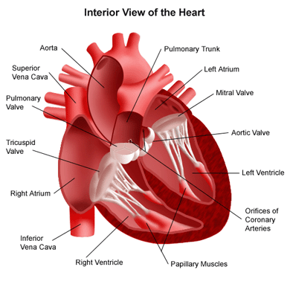
Chapter 10 circulatory system
Pgs. 310 - 339

Slide 2
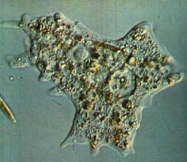
In The Beginning
For simple organisms (such as amebas) nutrients, gases, and wastes can enter/leave by simple means;
diffusion / osmosis / active transport
For more complex organism a transport system is needed!!
Your Circulatory System

Slide 3
Early Theories
Greeks
believed the heart was the center of human intelligence
a “innate heart” that generated four humors
black and yellow bile, phlegm and blood
Galen (Roman)
believed that blood did not circulate
thought that it might ebb like tides

Slide 4
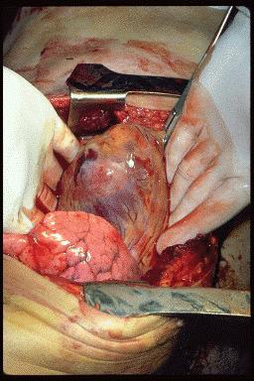
Early Theories
William Harvey
questioned Galen
reasoned that blood must circulate
dissected cadavers and examined blood vessels
tried to estimate the amount of blood and how much the heart could pump
Marcelo Malpighi
used a microscope to examine capillaries
he confirmed that circulation existed

Slide 5
10.1 – Blood Vessels

Slide 6
Blood Vessels
Arteries
&
Veins

Slide 7
Arteries and Arterioles
Arteries
* Carry blood away from the heart
* Thick walls composed of distinct layers
* Outer and inner layers primarily made of connective tissue
* Middle layers made up of muscle fibres and elastic connective tissue
* Arteries stretch to accommodate the inrush of blood

Slide 8
Arteries vs. Veins

Slide 9
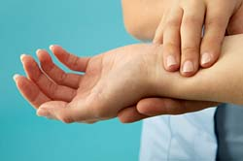
Pulse
Change in the diameter of the arteries following heart contractions
Can be felt near your wrist and on either side of your neck

Slide 10
Arterioles – smaller arteries
Autonomic nervous system – the part of the nervous system that controls the motor nerves that regulate equilibrium, and that is not under conscious control
Vasoconstriction – the narrowing of blood vessels, allowing less blood to the tissues
example: becoming pale when frightened – constriction of the arteriolar muscles diverts blood away from the outer capillaries of the skin toward the muscles.

Slide 11
Vasodilation – the widening of blood vessels, allowing more blood to the tissues
Example: blushing – vasodilation of arterioles leading to skin capillaries and red blood cells close to the surface of the skin produces a pink color

Slide 12
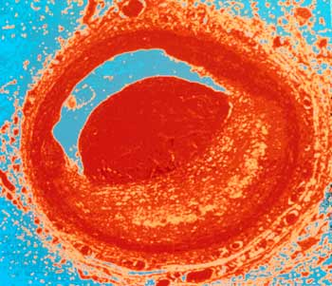
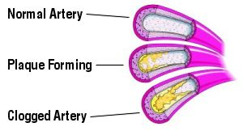
Atherosclerosis – a degeneration of blood vessels caused by the accumulation of fat deposits in the inner wall

Slide 13
Arteriosclerosis – a group of disorders that cause the blood vessels to thicken, harden, and lose their elasticity
* Can narrow arteries
* Can cause high blood pressure
* Blood clots can lead to the bursting of artery walls
* In the heart, narrowed or blocked arteries can lead to limited blood and oxygen flow to the heart causing chest pain or heart attack

Slide 14
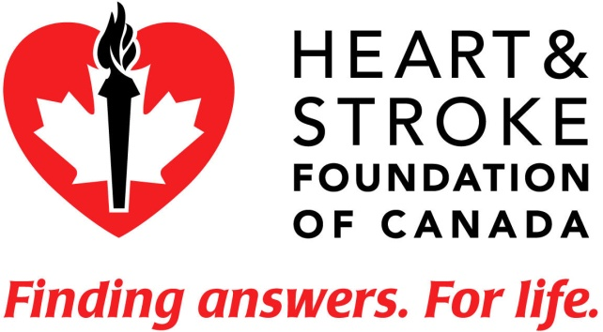
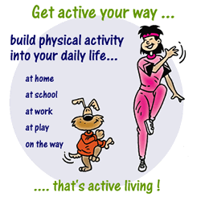
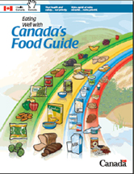
Heart Disease
* Every year heart disease kills more Canadians than any other disease.
* A low-fat diet and exercise are keys to prevention.

Slide 15
Aneurysm – a bulge in the weakened wall of a blood vessel, usually an artery
* Most common sites: aorta of the heart, abdominal aorta and arteries of the brain
* Most commonly caused by artherosclerosis
* An aneurysm in the brain is one of the conditions that can cause a stroke

Slide 16
Aneurysm

Slide 17
Five Signs of Stroke
Stroke can be treated. That’s why it is so important to recognize and respond to the warning signs.
Weakness - Sudden loss of strength or sudden numbness in the face, arm or leg, even if temporary.
Trouble speaking - Sudden difficulty speaking or understanding or sudden confusion, even if temporary.
Vision problems - Sudden trouble with vision, even if temporary.
Headache - Sudden severe and unusual headache.
Dizziness - Sudden loss of balance, especially with any of the above signs.
If you experience any of these symptoms, CALL 9-1-1 or your local emergency number immediately.

Slide 18
Capillaries
Smallest blood vessels (red blood cells must travel through capillaries in single file)
Only one cell thick
Site of fluid and gas exchange between blood and body cells
Capillary beds are very delicate and can be easily damaged by pressure or impact (bruise)
Oxygenated (oxygen rich) blood appears red
Deoxygenated (oxygen poor) blood appears purple-blue
Deoxygenated blood collects in small veins called venules and is carried back to the heart

Slide 19
Capillaries

Slide 20
Veins and Venules
Walls contain smooth muscle
Venules merge into veins with larger diameters
As blood flows from arteries to arterioles to capillaries, blood flow is greatly reduced and blood pressure in these smaller vessels is low
The pressure is not great enough to push blood back to the heart
Veins have valves that open in one direction, steering blood back to the heart
Skeletal muscles aide in blood flow in veins by creating a massaging action directing blood flow toward the heart.

Slide 21
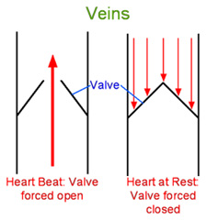
Veins

Slide 22
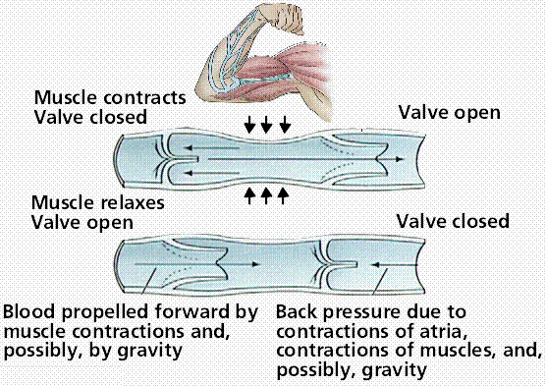

Slide 23
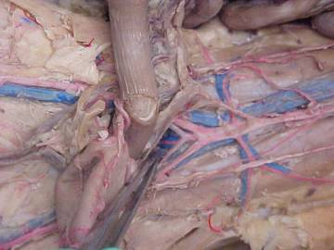
Arteries and Veins

Slide 24
Some Possible Disorders
Raynaud Syndrome
is a reversible condition in which the fingers or toes start throbbing and turning a whitish or blue colour because a contraction (vasospasm) of the small arteries has interfered with blood flow.
Symptoms;: there is no permanent change in the makeup of the blood vessels
the vessels will re-open, and the fingers or toes will slowly return to their healthy colour as blood flow is restored.
Individuals with Raynaud syndrome may also experience pain, throbbing or a prickly feeling in the extremities and, in extremely serious cases, damaged tissue and the possibility of permanent tissue death (gangreme).

Slide 25
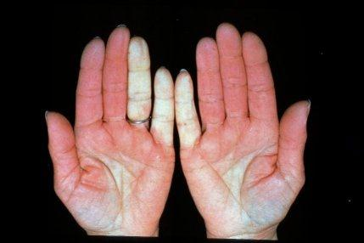

Slide 26
Some Possible Disorders
Buerger Disease
also known as thromboangiitis obliterans,
it is a rare type of peripheral arterial disease that involves inflammation of the smaller arteries in the extremities.
Causes: it is a progressive condition associated almost exclusively with tobacco use (smoking or smokeless tobacco), especially among young men.
Symptoms: As it worsens, people tend to feel increasing pain in their legs, particularly after exertion.
blood clots may also form in the tissues, leading to substantial or even complete blockage of the vessel.
in extreme cases, the fingers, toes or an even larger section of the extremities must be amputated.

Slide 27
Questions
Page 316 # 1-3
Page 318 # 3, 5 - 9

