Slide 1
Cross Over and Gene Mapping

Slide 2
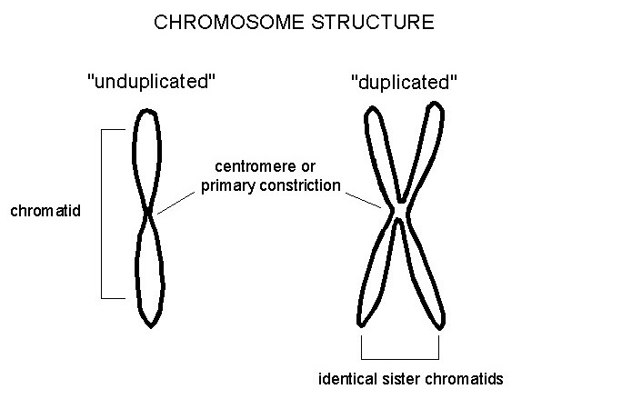
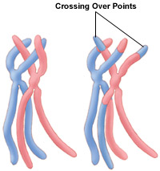
Genes closer together are less likely to be separated during crossover
Genes further apart are less likely to crossover together

Slide 3
Morgan observed that in some of the dihybrid crosses of Drosophila almost all of the offspring had the same combination of traits as did the parents. He concluded that these genes were located on the same chromosome
He did a cross of the F2 generation and didn’t get the expected 9:3:3:1 ratio. After doing the punnet square he didn’t get the expected 3:1 ratio either
 | AB | ab
AB | AABB | AaBb
ab | AaBb | aabb

Slide 4
To calculate Crossover percentage:
He noticed the following phenotypes and genotypes
Phenotype | Number | Possible genotype
wild-type body-colour, straight wings | 290 | AABB or AaBb
Black body-colour, curved wings | 92 | Aabb
Wild-type body colour, curved wings | 9 | Aabb or Aabb (indicated recombinations)
Black body-colour, straight wings | 9 | AaBB or aaBb (indicated recombinations)
$$crossover percentage=\frac{number of recombinations}{total number of offspring}x100\%$$

Slide 5
$$crossover percentage=\frac{number of recombinations}{total number of offspring}x100\%$$
$$\begin{matrix}crossover percentage= \frac{18}{400}x100\% \\ =4.5\% \\ 4.5\% crossover frequency so therfore said to be 4.5 map units apart\end{matrix}$$

Slide 6
: We observed the crossover frequency of genes A, B, C, and D shown below:
Sample 1 Question:
Related Genes: | Frequency Crossover will separate the 2 genes:
AB | 27% of the time crossover separates A from B
BC | 7% of the time crossover separates B from C
CD | 11% of the time crossover separates C from D
BD | 18% of the time crossover separates B from D
AD | 9% of the time crossover separates A from D

Slide 7
HINT:
Start with the highest percent difference
Look for sum of distances to add up to other distances!

Slide 8
Sample 2 Question: The recombination frequency between gene A and gene B is 9%; between A and C is 17%; and between B and C is 26%. What is the sequence of genes in the chromosome?

Slide 9
Sample 3 Question: Put the following in order.
HI – 42%
HJ – 10%
KI – 10%
JK – 22%

Slide 10
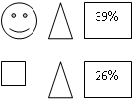
Sample 4 Question: What is the possible distance between and ?

Slide 11
Sample 5 Question: Choose the most likely situation given the following:
DF – 49%
EF – 30%
FG – 6%
a)DE = 21%
B) DG = 55%
C) EF = 34%
D) EG = 32%

